Slide 1
ENSE 483 Project
Group G - Pig Farm Management IoT System
Daniel Shevtsov (SID: 200351253)

Slide 2
Outline
Problem statement
Architecture overview
Dive into each component + demos
Conclusion

Slide 3
“
The main goal of this UC is … collecting crucial information, automating data collection and linking data to provide feedback to the farmer via an easy-to-use interface.
”
IoF 2020 Use Case Architectures and Overview of the Related IoT systems
UC 5.1: Pig Farm Management

Slide 4
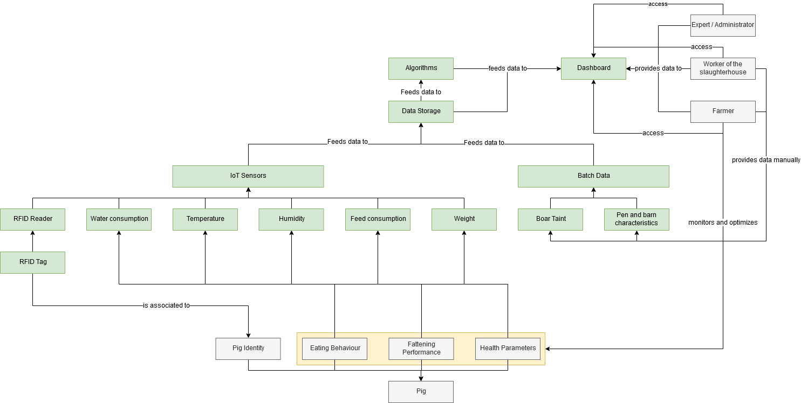
Problem statement
Notes:
Domain model
Physical entities in grey, hardware/software in green

Slide 5
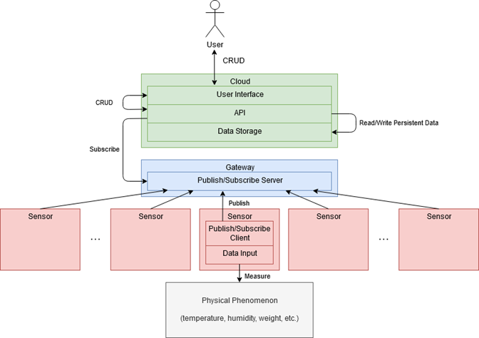
Problem statement
Notes:
Generic IoT architecture

Slide 6
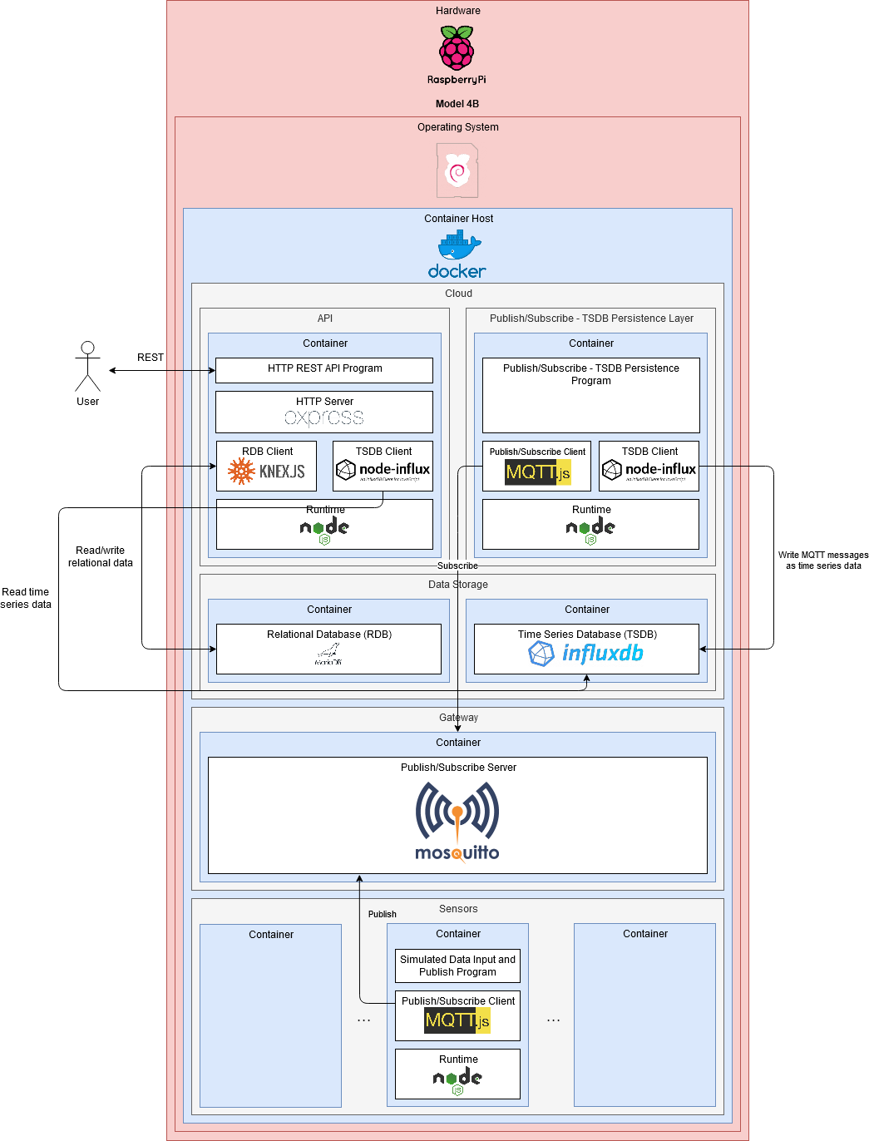
Big Picture
Notes:
Big diagram, confusing
Goal to walk through step by step, cover everything

Slide 7
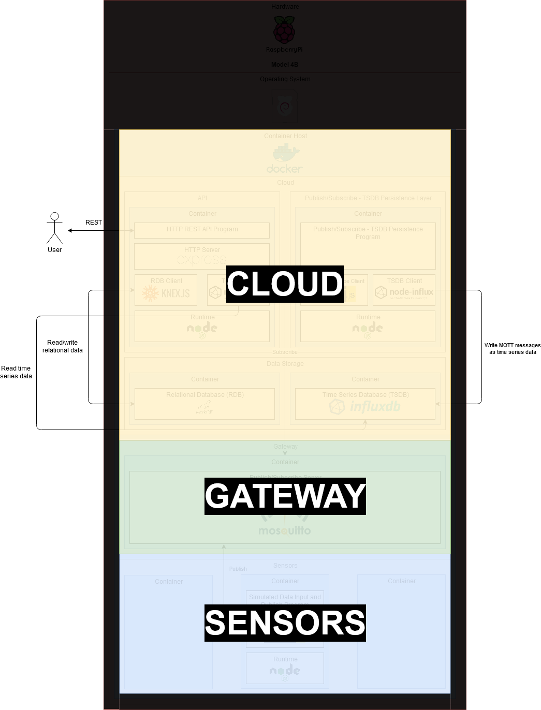
Big picture
All three IoT components on one hardware component
One cloud
One gateway (or more)
Many sensors

Slide 8
Big Picture

Slide 9
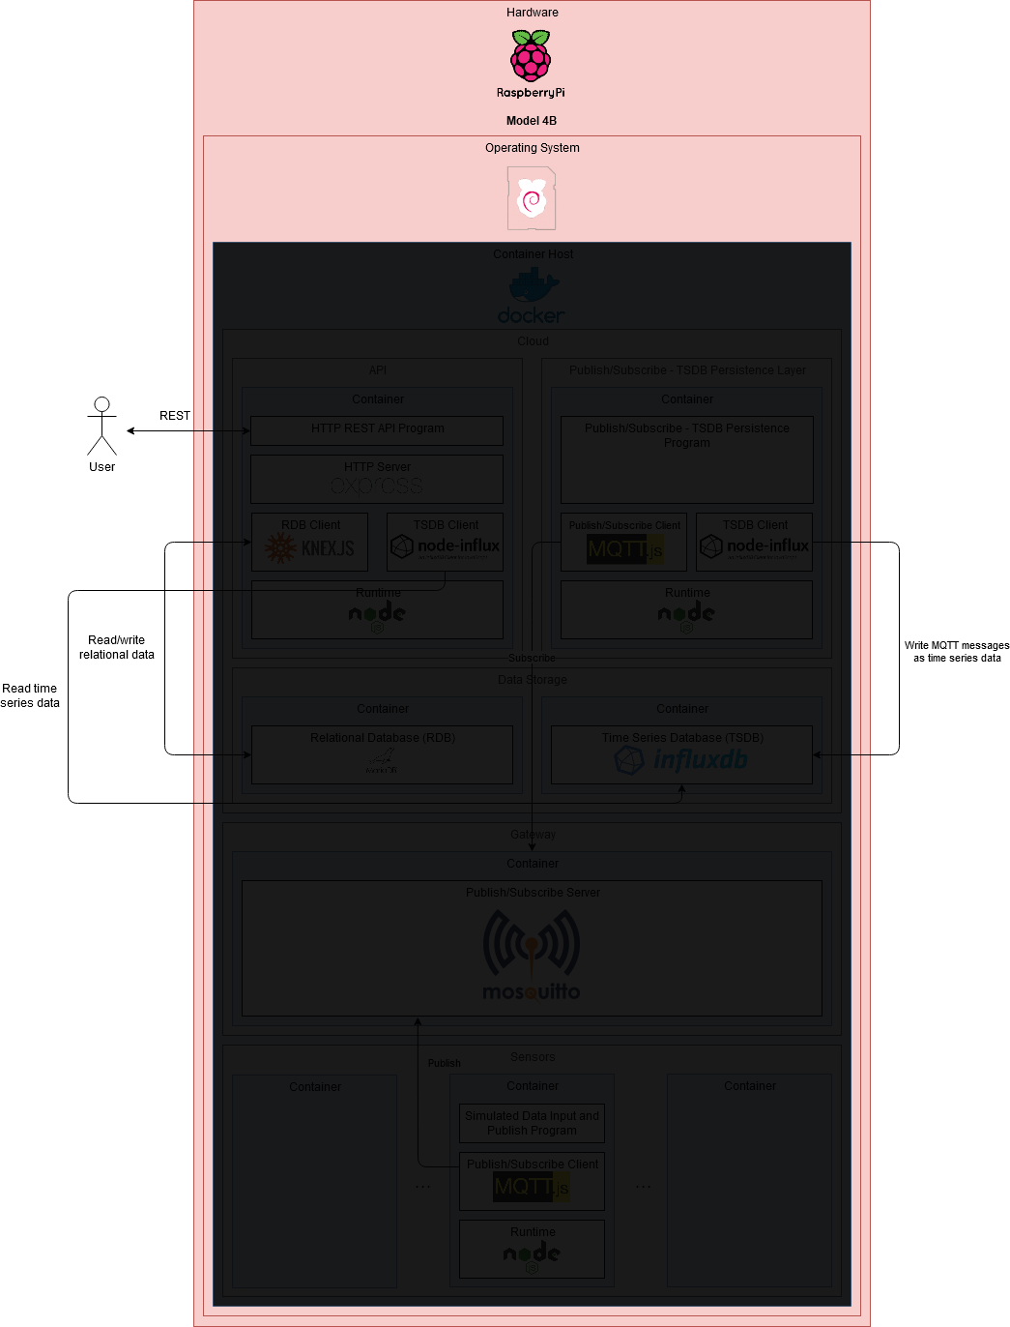
The hardware

Slide 10
The hardware
Raspberry Pi Model 4B (2019 model)
Operating System is Linux
Raspbian Buster
September 2019 version
Why?
Cheap
Commonly used for IoT
Fun project to learn something new!
Notes:
Developed on a Windows PC, deployed to “production” on the Raspberry Pi
Typically use many Pis in IoT, each as a sensor

Slide 11
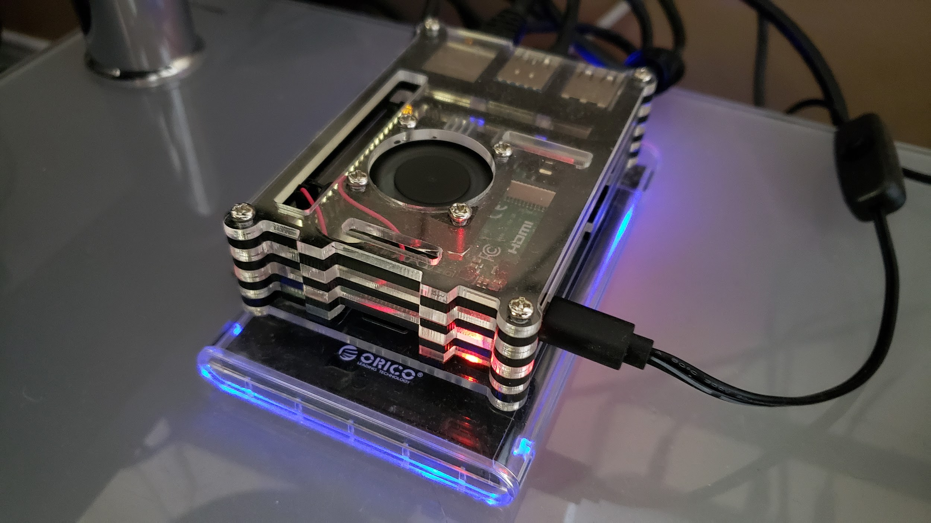
The Hardware
CPU: Quad-core ARM v8 (64-bit) @ 1.5GHz Broadcom BCM2711
RAM: 4GB LPDDR4-3200 SDRAM
HDD: 240GB Kingston A400 SSD
Notes:
Only hardware involved in the whole project

Slide 12
The hardware

Slide 13
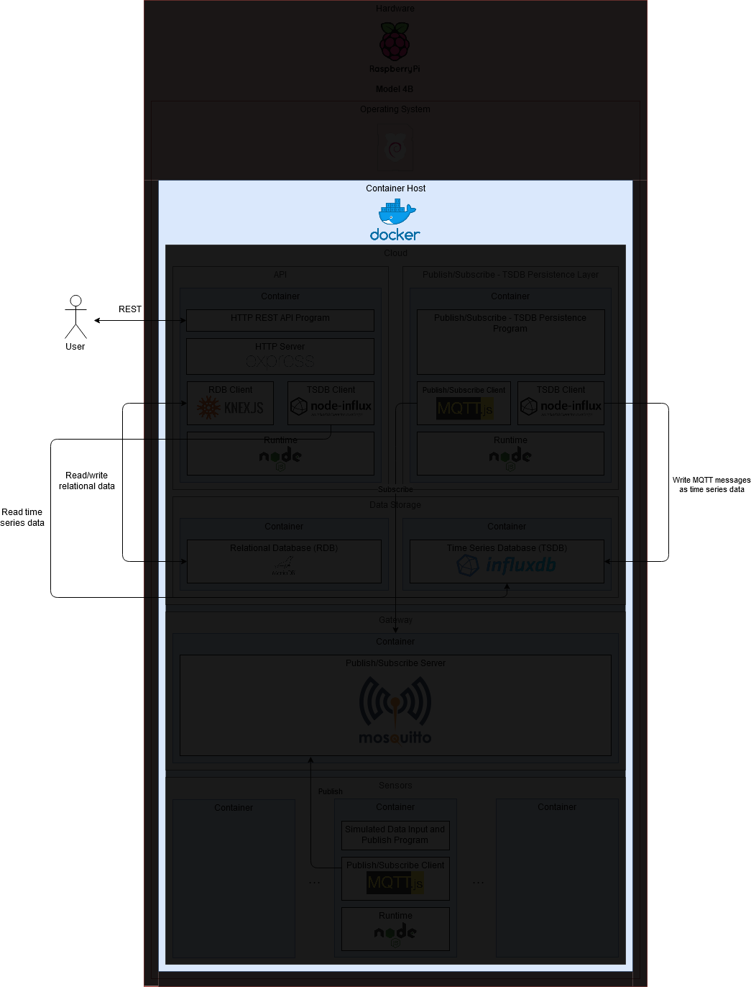
Virtualization

Slide 14
Virtualization
Docker!
The only thing (other than OS) installed on the Pi
Everything else “virtualized” as a container
Why?
Easy to set up and tear down
Community support
Fun project to learn something new!
Notes:
Need a way to run lots of software on one device reliably
Simulate hardware components like physical sensors as software processes

Slide 15
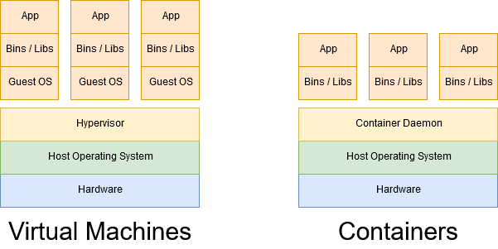
Virtual Machines vs Containers
Notes:
Commonly used diagram
VMS are heavy (operating system overhead)
Containers sometimes called “operating system-level virtualization”
Containers share the host’s operating system kernel but have their own binaries and libraries
VMs scale vertically (increase HW specs), containers scale horizontally (launch more containers)

Slide 16
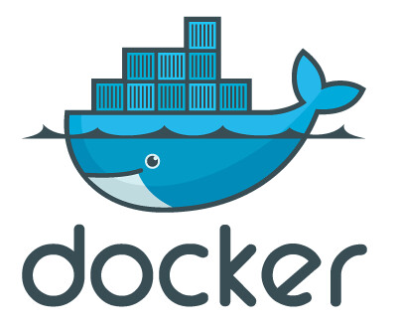
What is Docker?
Developed by “dotCloud,” now “Docker, Inc.”
FOSS, released in 2013
PaaS product
Main component is Docker Engine
Some other supporting products
Docker Compose
Docker Swarm
Docker Hub
Enterprise support
Notes:
PaaS - Platform as a Service. Developers write, run, and manage their applications without worrying about underlying infrastructure
Docker Engine - daemon or container runtime

Slide 17
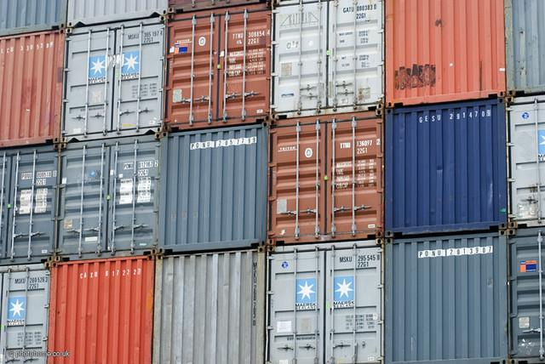
Why use Docker?
Benefits:
Lighter than VMs
Faster start time than VMs
Sandboxed
Multi-arch (x86, ARM, etc.)
Use cases:
Consistent development environments
Continuous Integration
Replacement for VMs in enterprise

Slide 18





Who uses Docker?
Sources:
https://www.docker.com/customers
https://cloud.google.com
https://aws.amazon.com
https://azure.microsoft.com
… and many more!

Slide 19

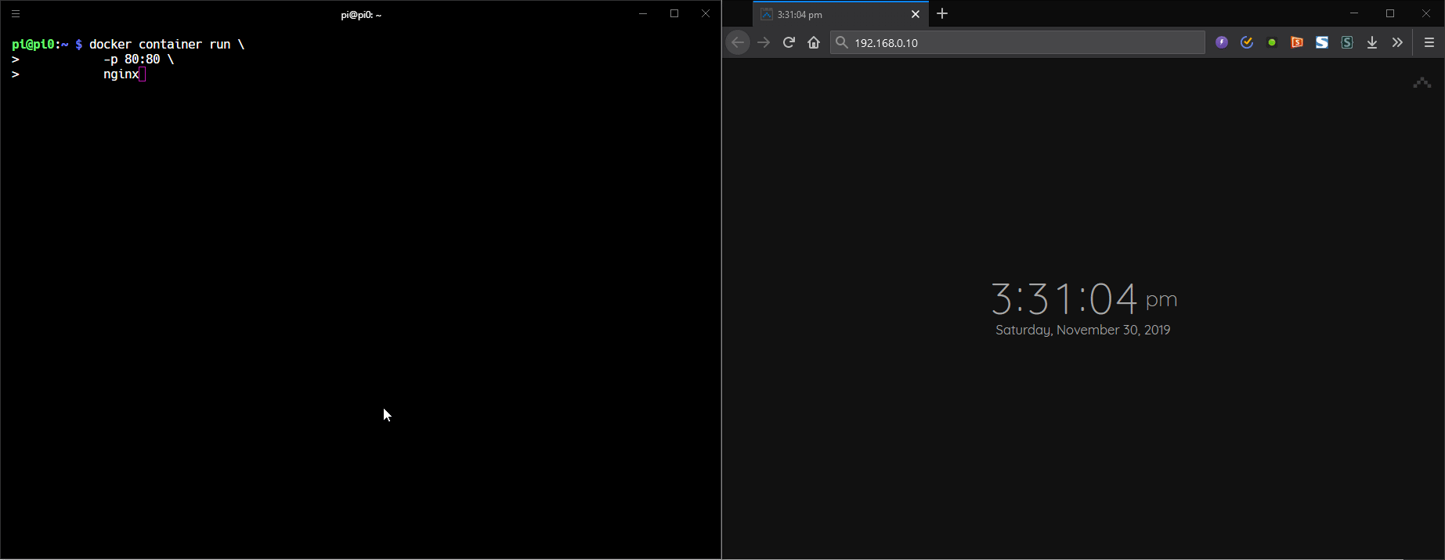
So how do Docker containers work?
Let’s run a web server!

Slide 20

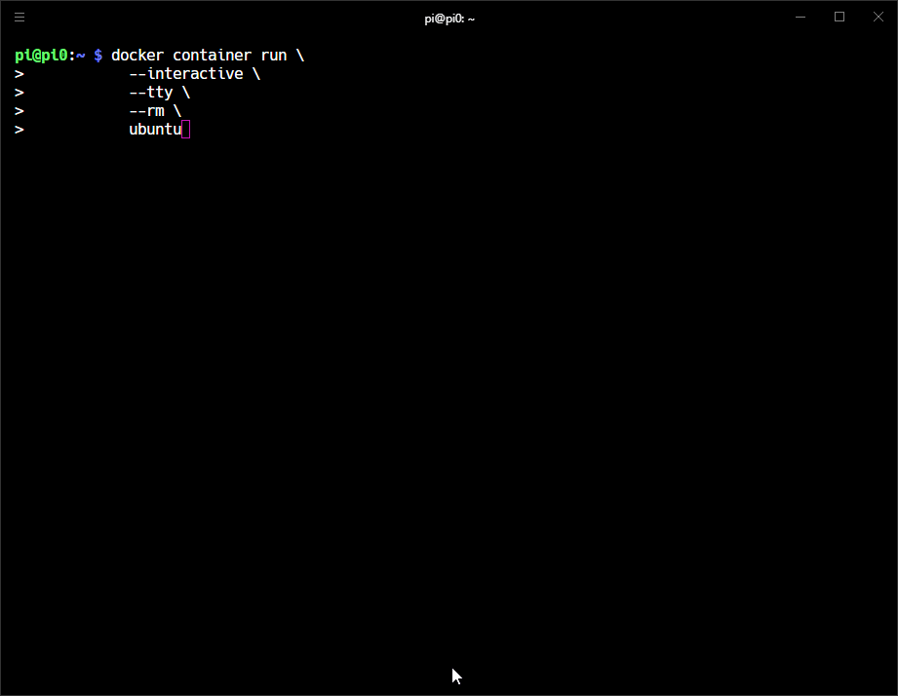
So how do Docker containers work?
How about a Linux distro?

Slide 21
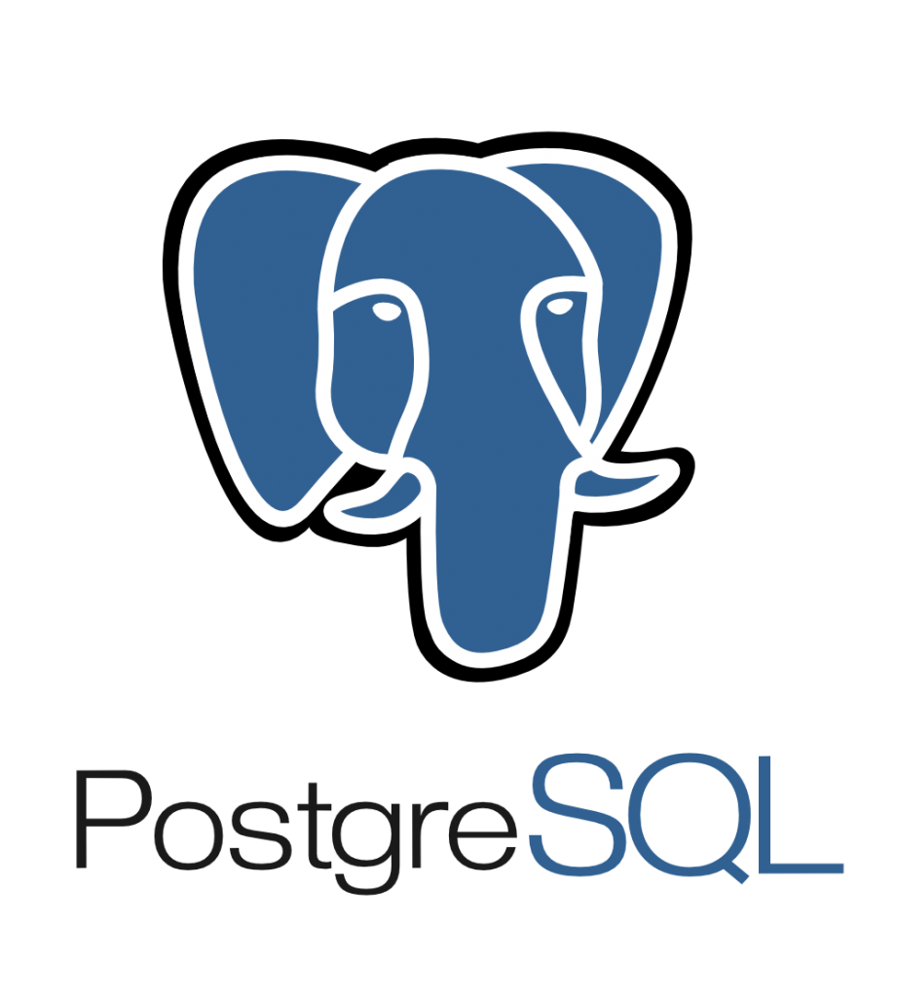
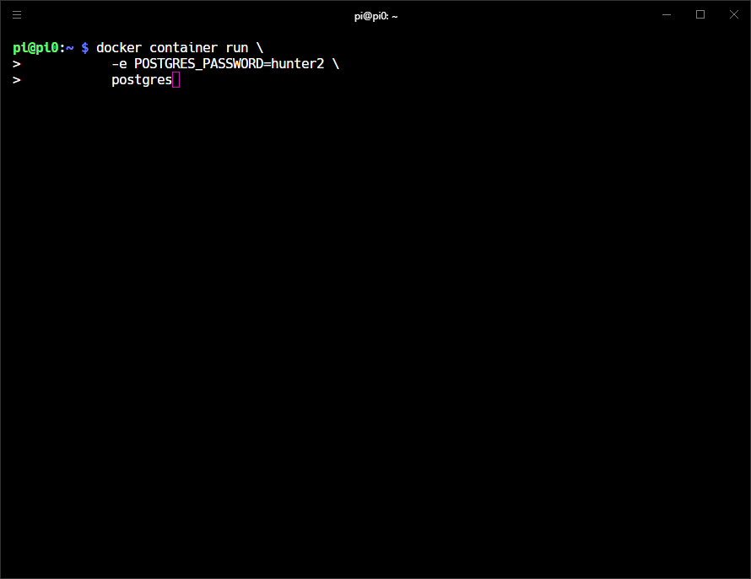
So how do Docker containers work?
And an SQL database?

Slide 22
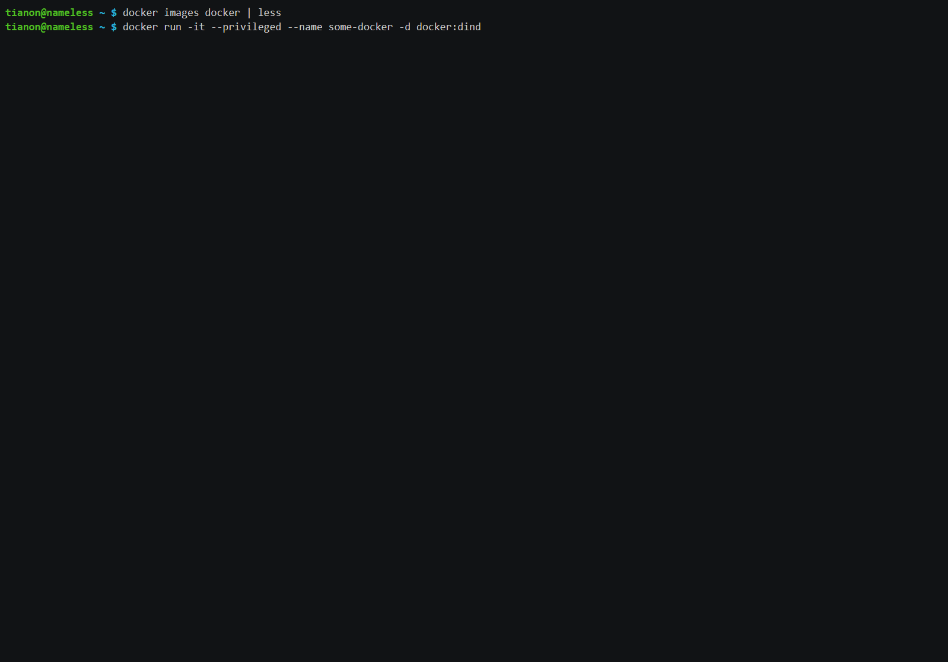
So how do Docker containers work?
Courtesy of https://hub.docker.com/_/docker
Bonus: Docker in Docker???

Slide 23
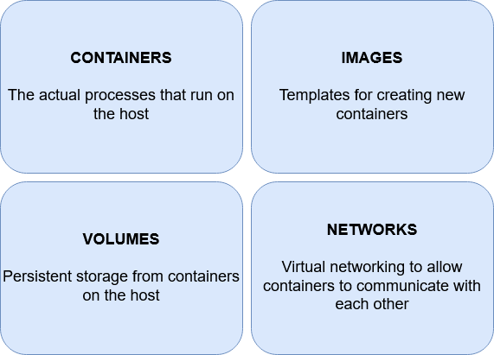
What can Docker do?
Docker Engine manages 4 main components:

Slide 24
Creating images, networks, volumes, and containers
A basic example that involves creating each of the 4 components:
1. Image
docker image pull mysql
2. Network
docker network create my-network
3. Volume
docker volume create my-volume
Notes:
Not actually creating an image, just pulling an existing remote volume

Slide 25
Creating images, networks, volumes, and containers
4. Container
docker container run \
--network=my-network \
--volume=my-volume:/var/lib/mysql \
--expose=[“3306:3306”] \
-e MYSQL_ROOT_PASSWORD=my-password \
mysql

Slide 26
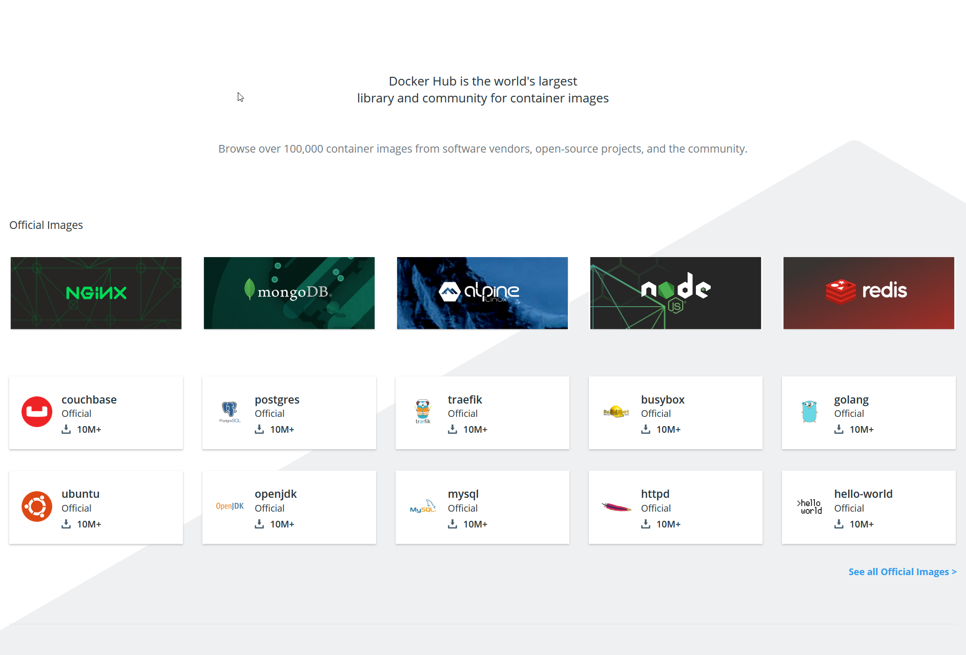
Getting images from Docker Hub
Docker Hub is an image registry. It’s like what GitHub is source code, but for Docker images.

Slide 27
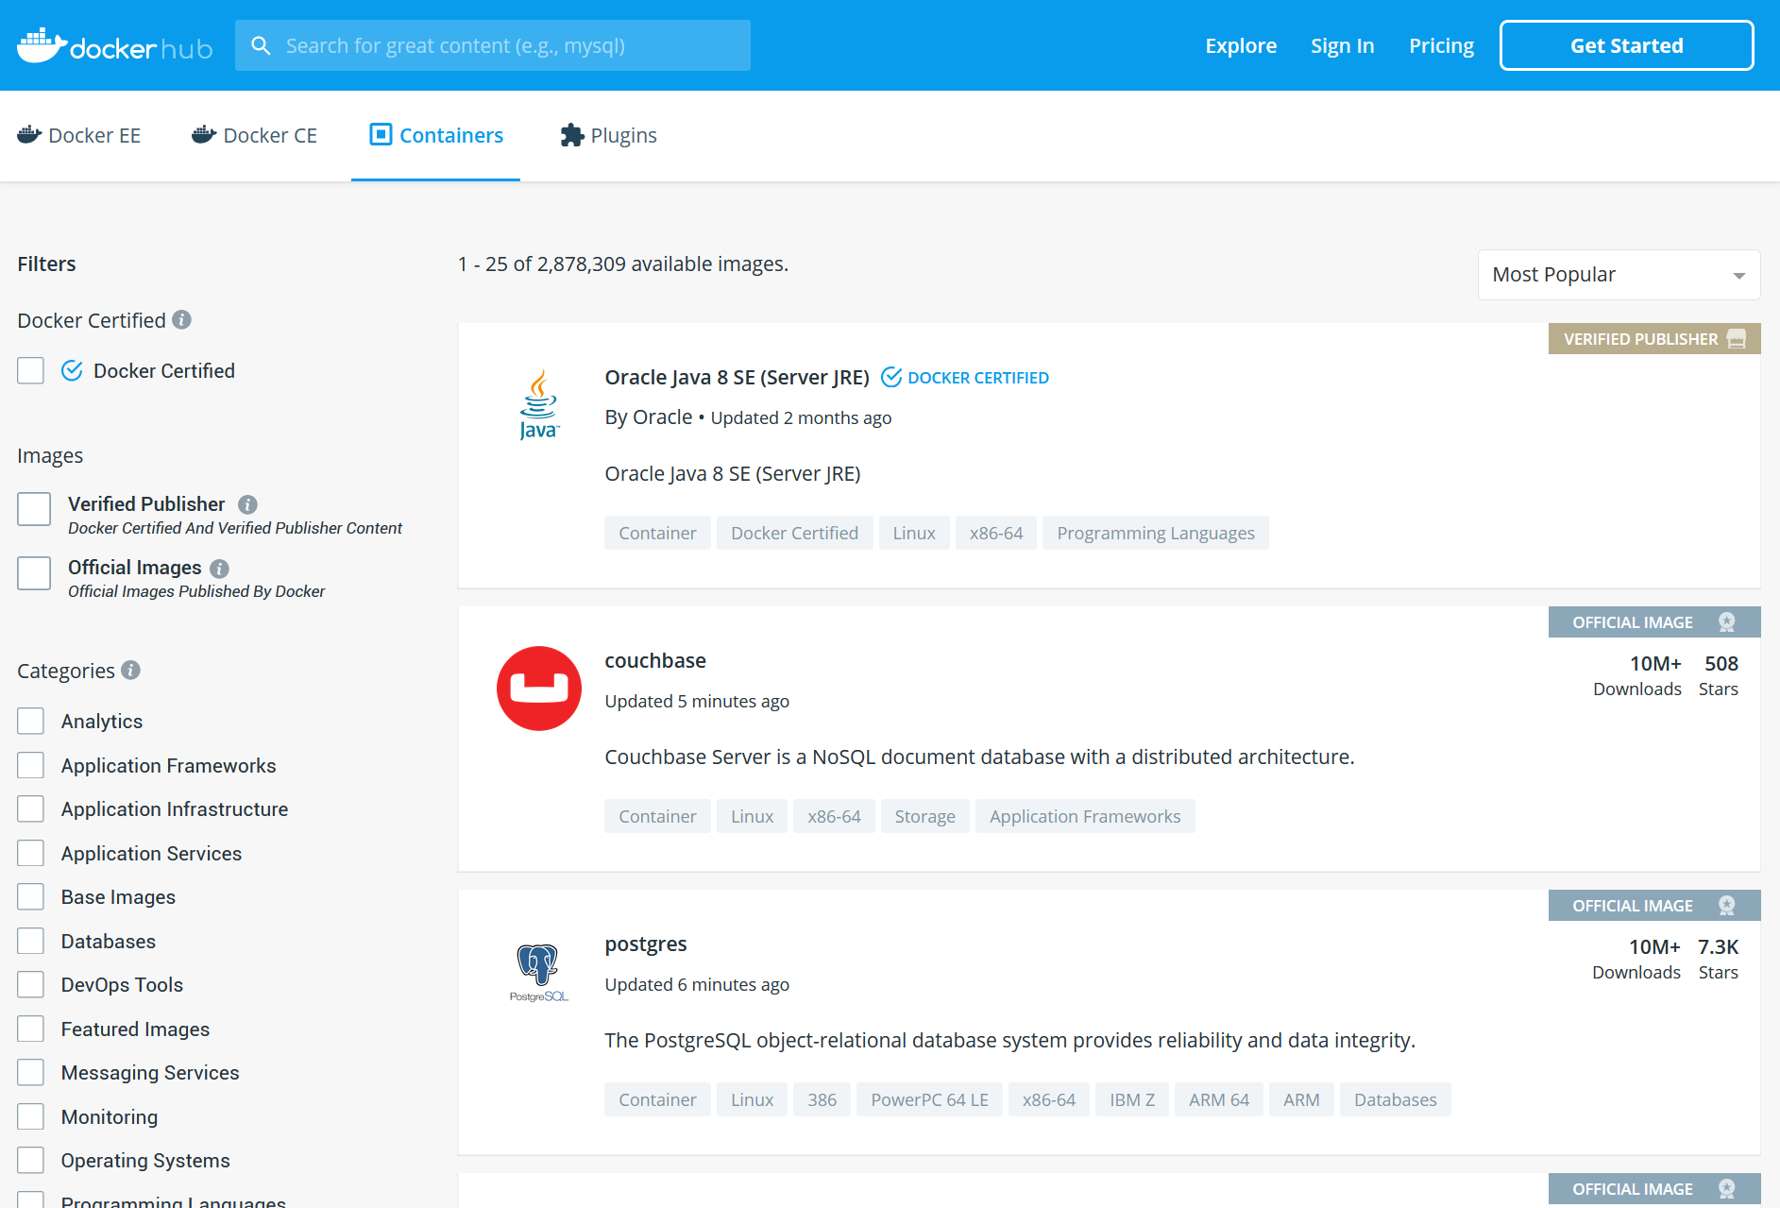
Getting images from Docker Hub
Docker Hub is an image registry. It’s like what GitHub is source code, but for Docker images.

Slide 28
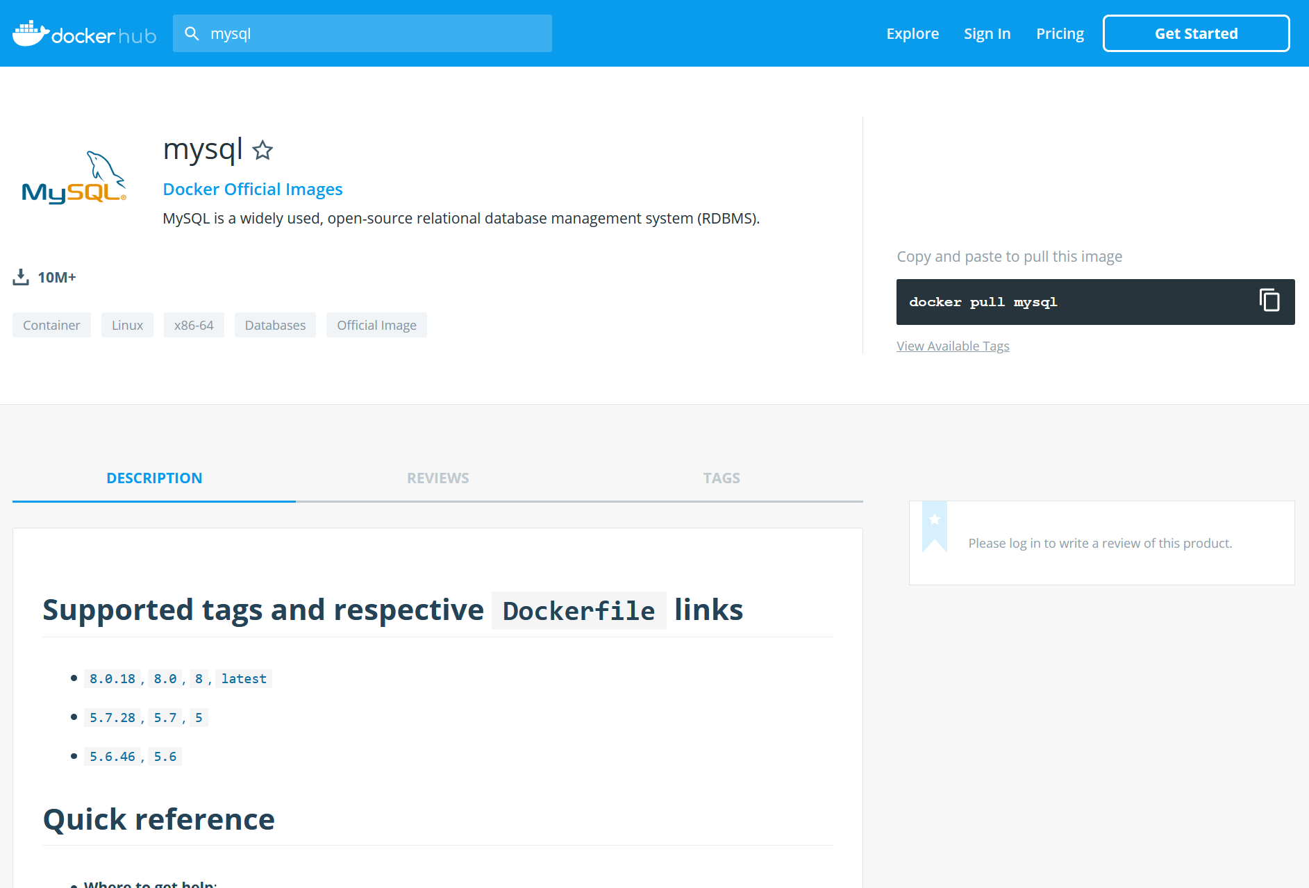
Getting images from Docker Hub
Docker Hub is an image registry. It’s like what GitHub is source code, but for Docker images.

Slide 29
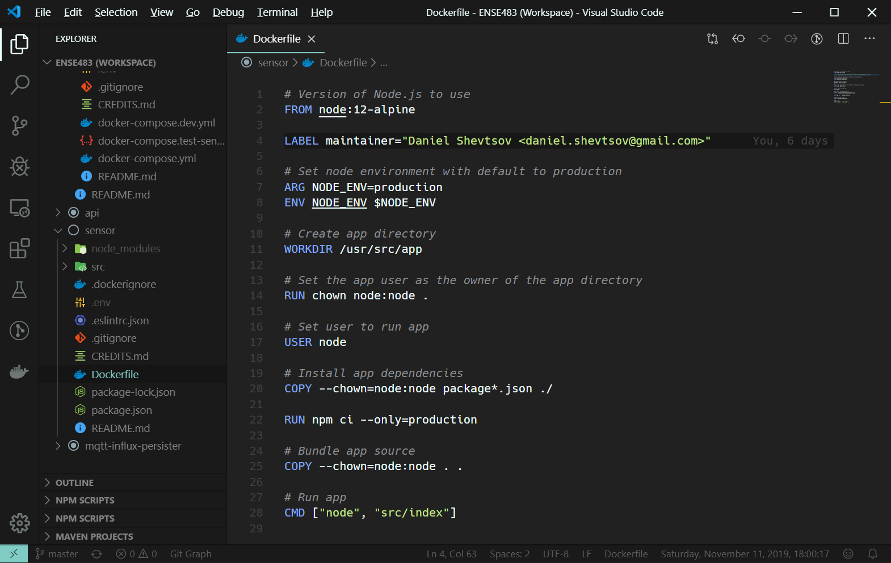
Creating our own images
Images are created from recipes called Dockerfiles.

Slide 30
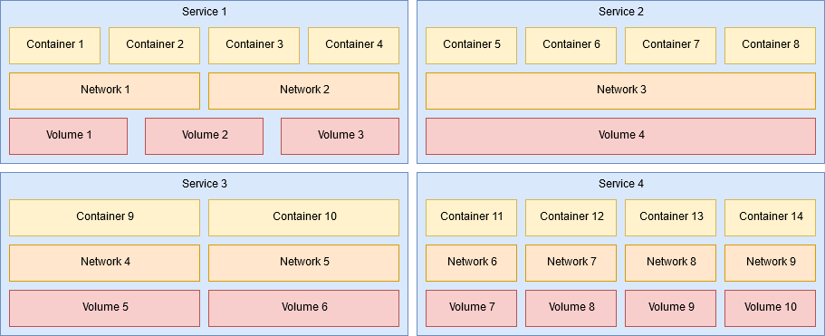
Using Docker Compose
Can create containers one by one and make them work together.
Alternatively, use Docker Compose to automate this.
A set of related containers, networks, and volumes are one service.

Slide 31
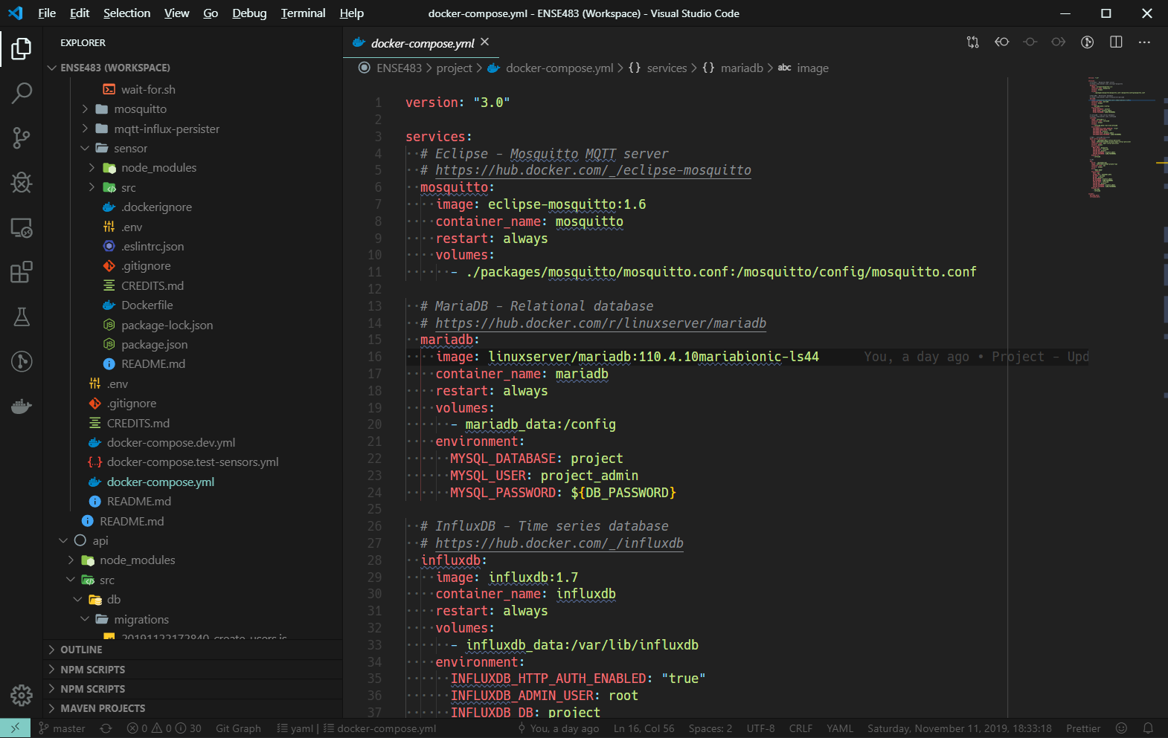
Using Docker Compose
We write a docker-compose.yml file and define the containers, networks, and volumes in our service.
Notes:
Docker Swarm mode: Orchestrate multiple physical hosts as one big Docker cluster

Slide 32
Virtualization

Slide 33
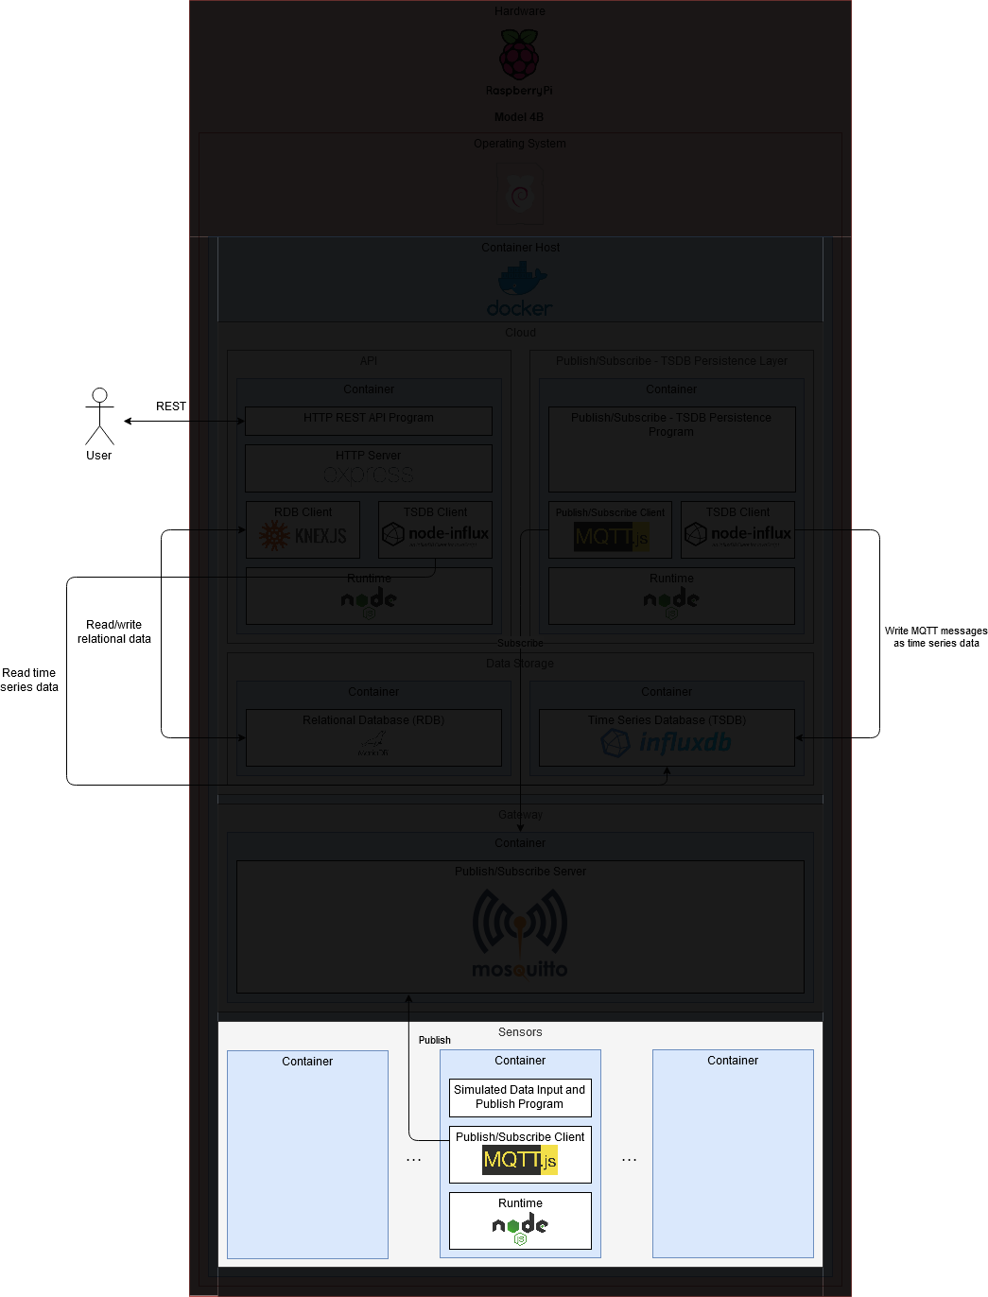
Sensors

Slide 34
Sensors
Measures some physical phenomenon
Converts to a digital value
Publishes value
Many sensors
Notes:
Should be a physical device, but I simulate it as software (a Docker container)
Custom software I wrote for the project

Slide 35
Requirements for the sensor
Generate random values in a range to simulate measurements
Publish values as MQTT messages

Slide 36
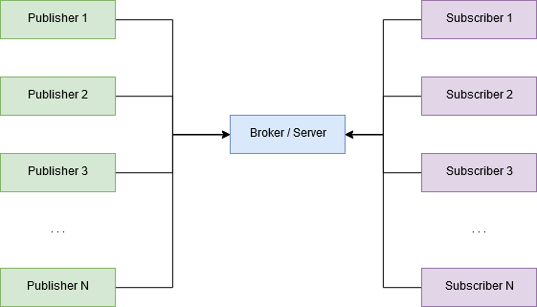
What is MQTT?
Message Queuing Telemetry Transport
Lightweight publish-subscribe protocol
One broker (server), many publishers and subscribers (clients)
Publishers submit data, subscribers listen for data
Notes:
Has some quality of service features (queue priority, delivery guarantee) that I have not used

Slide 37
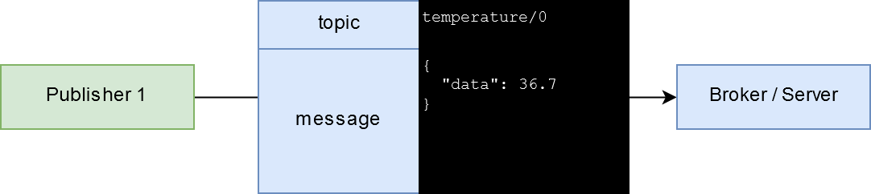
What is MQTT?
Minimum information required to publish data:
Topic
Message
Topic can be any string. For hierarchical data, decide on a consistent format to use like “level1/level2/level3/…”
Message can be any string of text. Can decide to use a consistent format like XML or JSON
Notes:
Has some quality of service features (queue priority, delivery guarantee) that I have not used

Slide 38
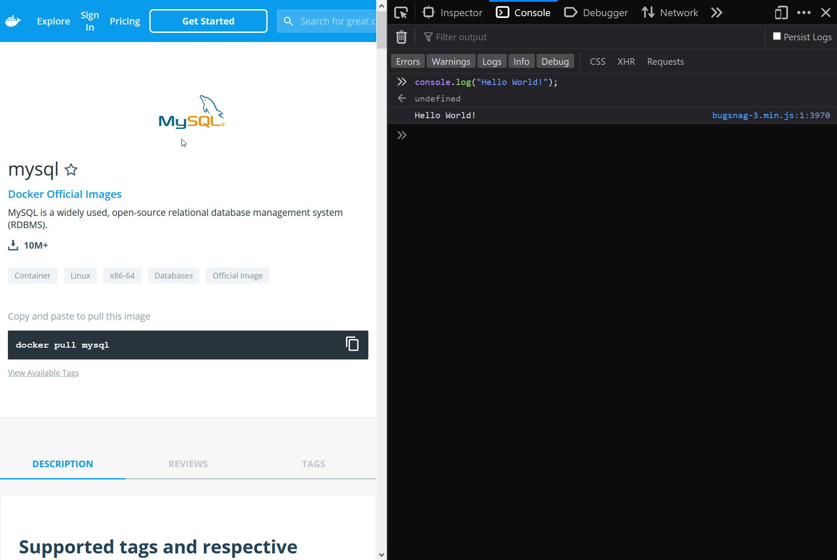
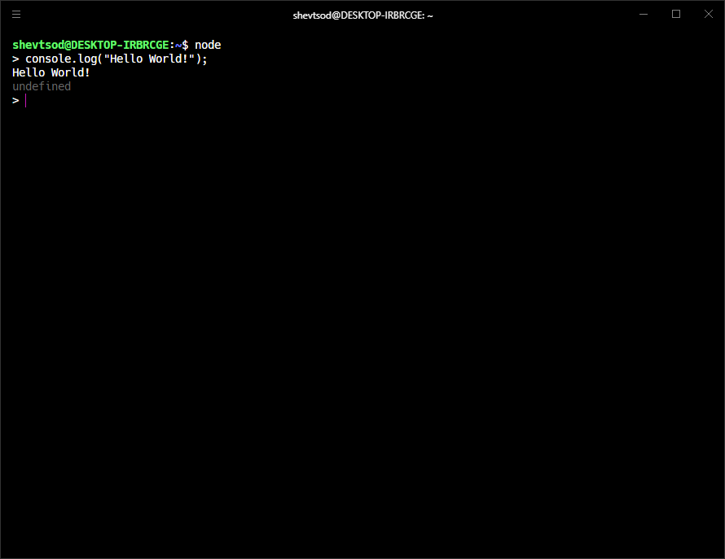
What is Node.js?
JavaScript originally made to run scripts on web pages
Node.js allows JavaScript to be run outside of a web browser
Use JavaScript as a general purpose programming language (like Python, Ruby, C++, C#, etc.)

Slide 39
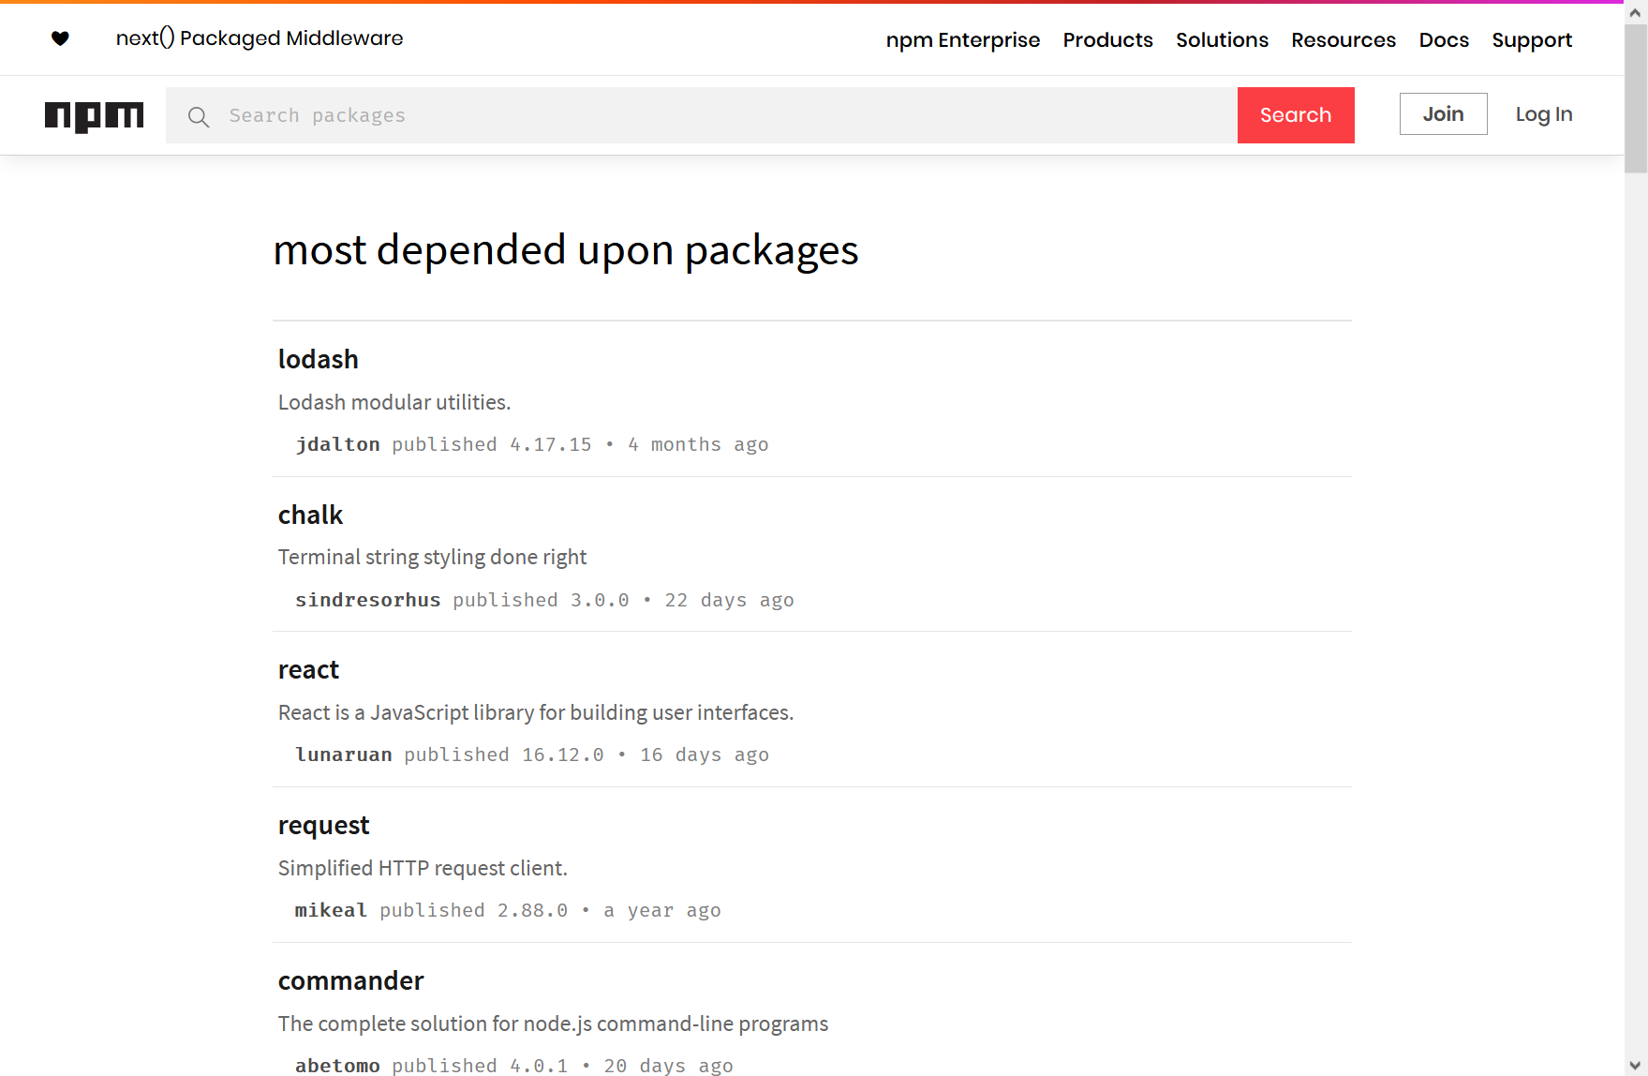
What is Node.js?
Includes Node Package Manager (NPM)
A package registry that lets anyone share packages, libraries, etc.

Slide 40
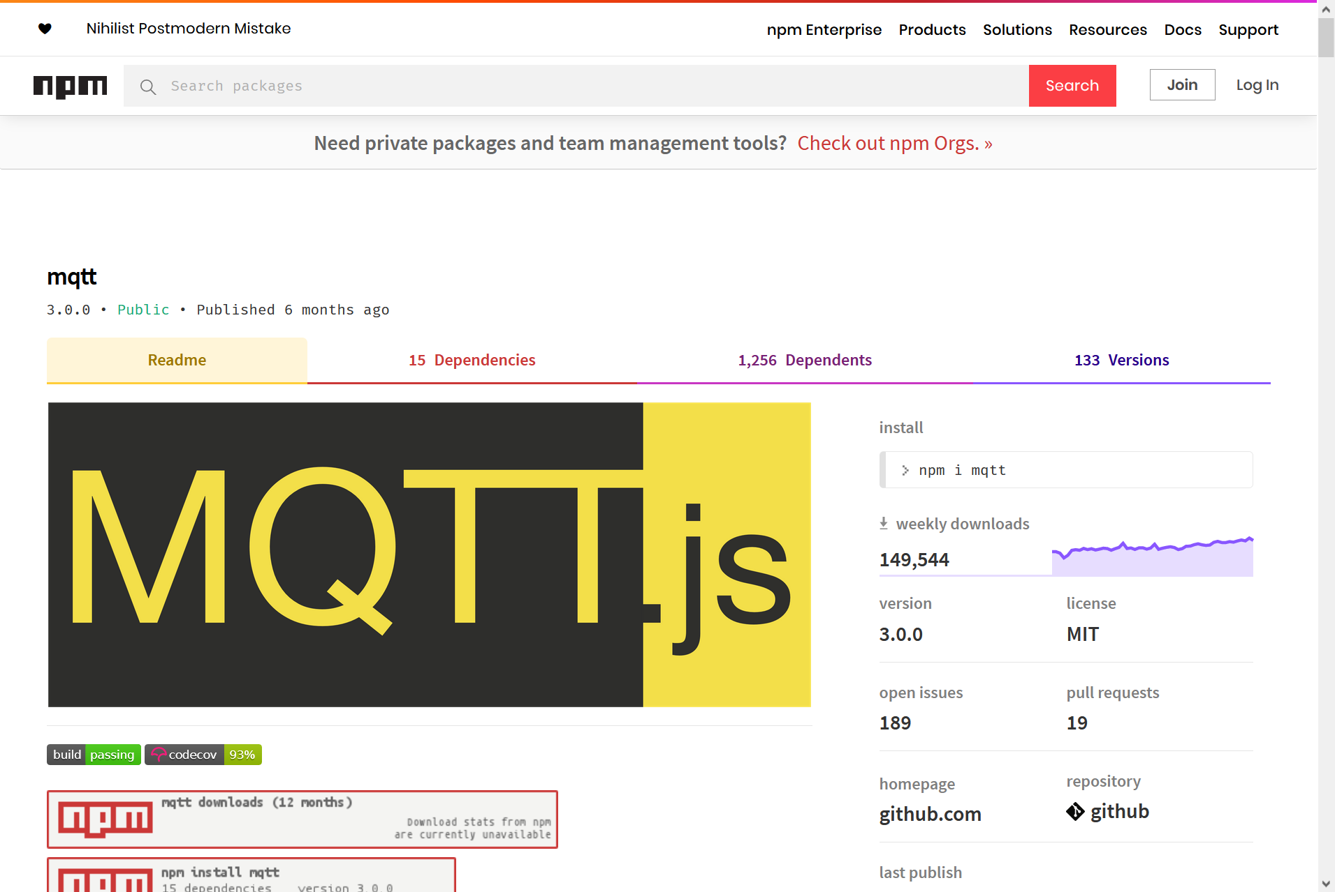
MQTT.js
An MQTT client library hosted on NPM
Event-driven API
// Create MQTT client and attempt to connect to the server
const mqttClient = mqtt.connect(mqttUrl);
// When connected, publish random measurement
mqttClient.on('connect', () => {
// Message body/contents
const payload = JSON.stringify({
data: generateRandomNumber(env.VALUE_MIN, env.VALUE_MAX),
});
// Publish the message
mqttClient.publish(env.MQTT_PUB_TOPIC, payload);
});
// Handle MQTT server disconnection event
mqttClient.on('close', () => {
logger.info(`Disconnected from MQTT server at "${mqttUrl}"`);
});

Slide 41
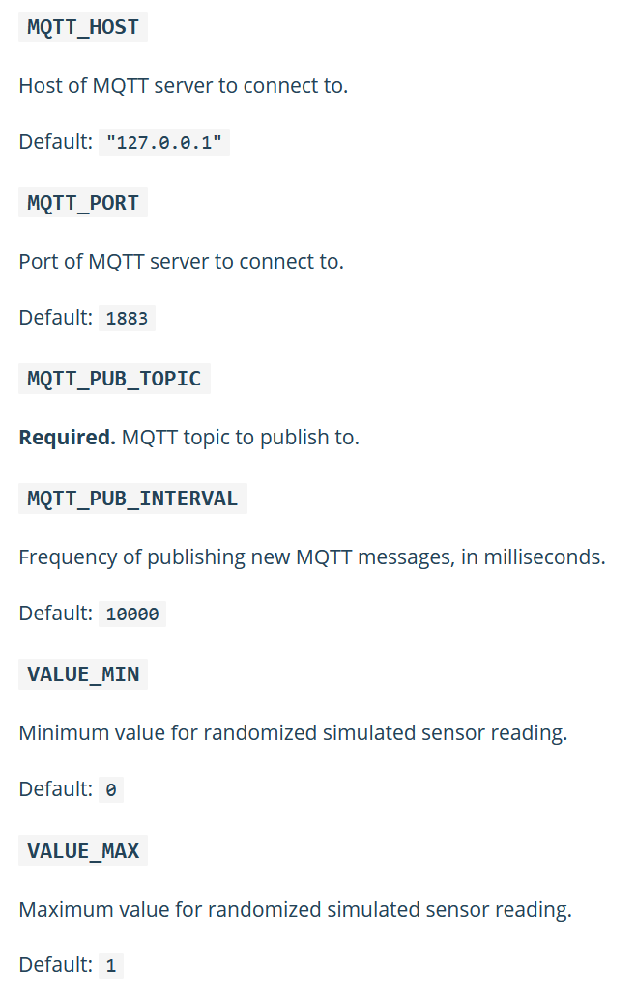
Environment variables
Notes:
In Docker, pass env vars to change container behaviour

Slide 42
Dockerfile
# Version of Node.js to use
FROM node:12-alpine
LABEL maintainer="Daniel Shevtsov <daniel.shevtsov@gmail.com>"
# Set node environment with default to production
ARG NODE_ENV=production
ENV NODE_ENV $NODE_ENV
# Create app directory
WORKDIR /usr/src/app
# Set the app user as the owner of the app directory
RUN chown node:node .
# Set user to run app
USER node
# Install app dependencies
COPY --chown=node:node package*.json ./
RUN npm ci --only=production
# Bundle app source
COPY --chown=node:node . .
# Run app
CMD ["node", "src/index"]

Slide 43
docker-compose.yml entries
version: "3.0"
services:
sensor-temperature-1:
build: ./packages/sensor
image: shevtsod/ense483-project-sensor
restart: always
environment:
MQTT_HOST: mosquitto
MQTT_PUB_TOPIC: temperature/1
MQTT_PUB_INTERVAL: 20000
VALUE_MIN: 40
VALUE_MAX: 42
sensor-temperature-2:
image: shevtsod/ense483-project-sensor
restart: always
environment:
MQTT_HOST: mosquitto
MQTT_PUB_TOPIC: temperature/2
MQTT_PUB_INTERVAL: 20000
VALUE_MIN: 38
VALUE_MAX: 40
depends_on:
- sensor-temperature-1
sensor-temperature-3:
image: shevtsod/ense483-project-sensor
restart: always
environment:
MQTT_HOST: mosquitto
MQTT_PUB_TOPIC: temperature/3
MQTT_PUB_INTERVAL: 20000
VALUE_MIN: 36
VALUE_MAX: 38
depends_on:
- sensor-temperature-1
sensor-weight-1:
image: shevtsod/ense483-project-sensor
restart: always
environment:
MQTT_HOST: mosquitto
MQTT_PUB_TOPIC: weight/1
MQTT_PUB_INTERVAL: 60000
VALUE_MIN: 140
VALUE_MAX: 142
depends_on:
- sensor-temperature-1
sensor-weight-2:
image: shevtsod/ense483-project-sensor
restart: always
environment:
MQTT_HOST: mosquitto
MQTT_PUB_TOPIC: weight/2
MQTT_PUB_INTERVAL: 60000
VALUE_MIN: 162
VALUE_MAX: 166
depends_on:
- sensor-temperature-1
sensor-weight-3:
image: shevtsod/ense483-project-sensor
restart: always
environment:
MQTT_HOST: mosquitto
MQTT_PUB_TOPIC: weight/3
MQTT_PUB_INTERVAL: 60000
VALUE_MIN: 152
VALUE_MAX: 156
depends_on:
- sensor-temperature-1

Slide 44
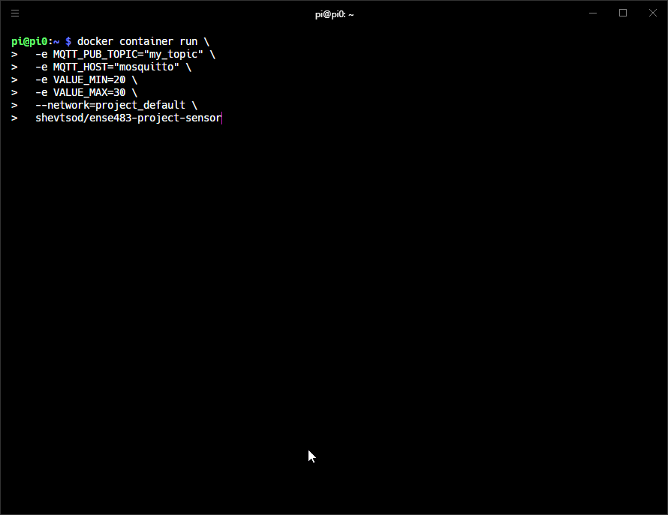
Demo

Slide 45
Sensors

Slide 46
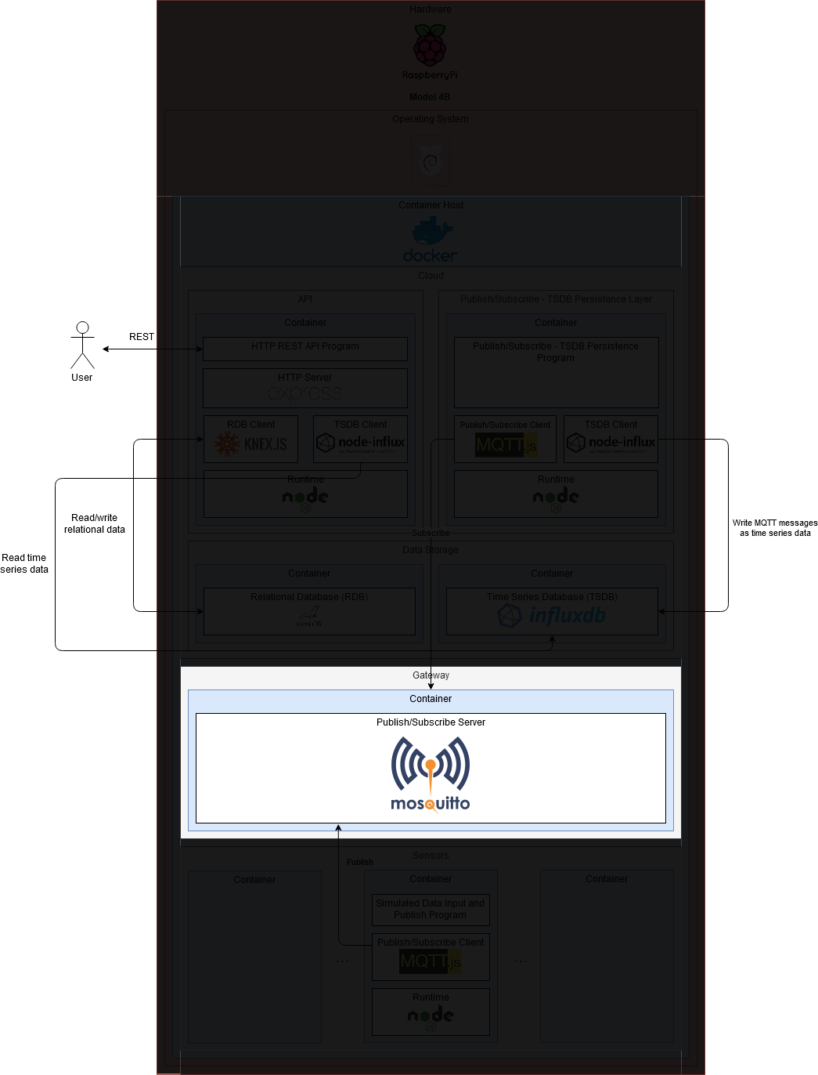
Gateway

Slide 47
Gateway
Aggregates sensor measurements
Forwards the data to the cloud
One or more gateways
Notes:
In my project: Black box that receives messages from publishers and broadcasts them to subscribers

Slide 48
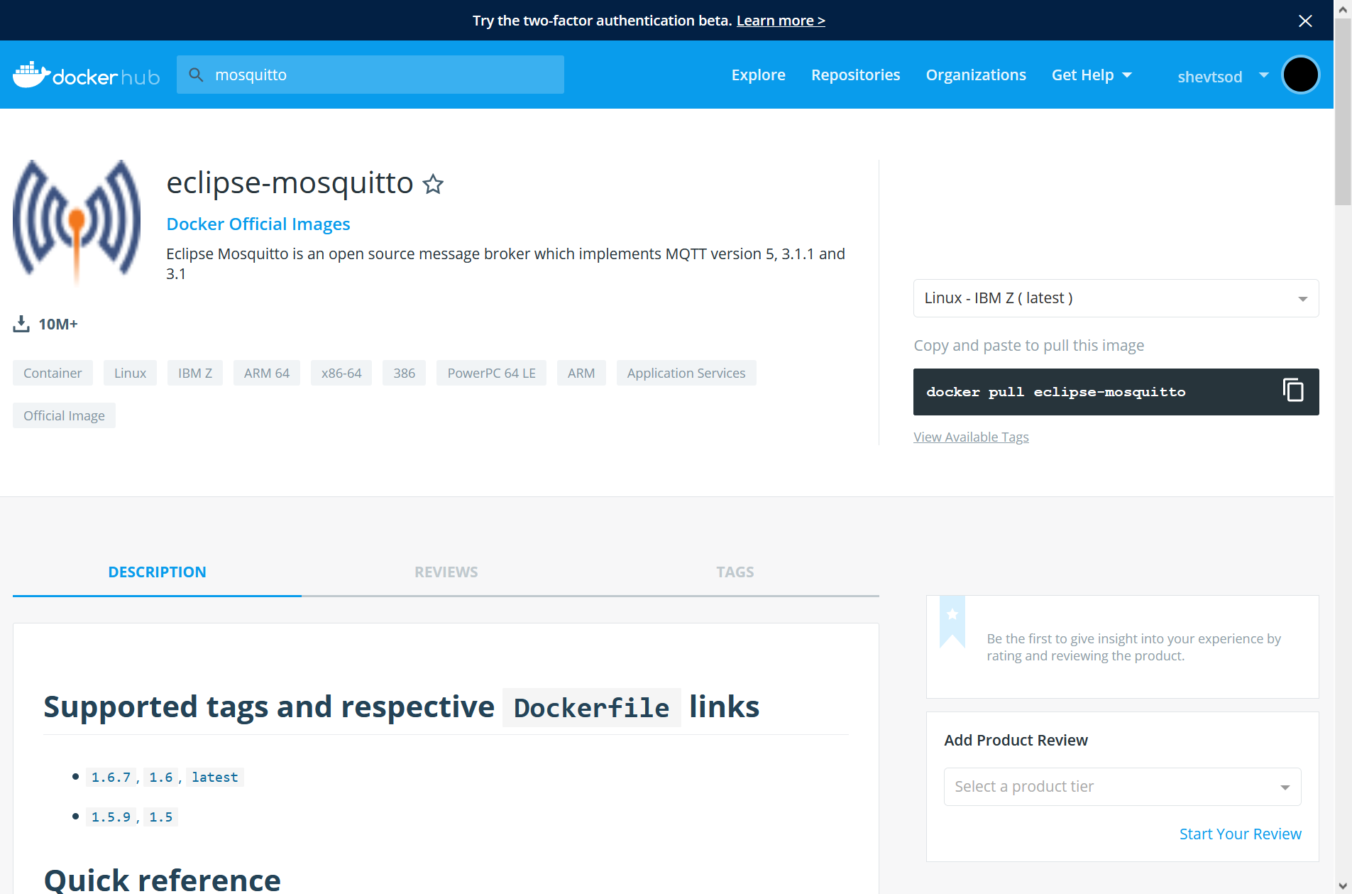
Eclipse Mosquitto
An open-source MQTT broker made by Mosquitto
Available as a Docker image (one of the most popular!)
docker container run \
-it \
-p 1883:1883 \
-p 9001:9001 \
eclipse-mosquitto

Slide 49
docker-compose.yml entries
version: "3.0"
services:
# Eclipse - Mosquitto MQTT server
# https://hub.docker.com/_/eclipse-mosquitto
mosquitto:
image: eclipse-mosquitto:1.6
container_name: mosquitto
restart: always
volumes:
- ./packages/mosquitto/mosquitto.conf:/mosquitto/config/mosquitto.conf

Slide 50
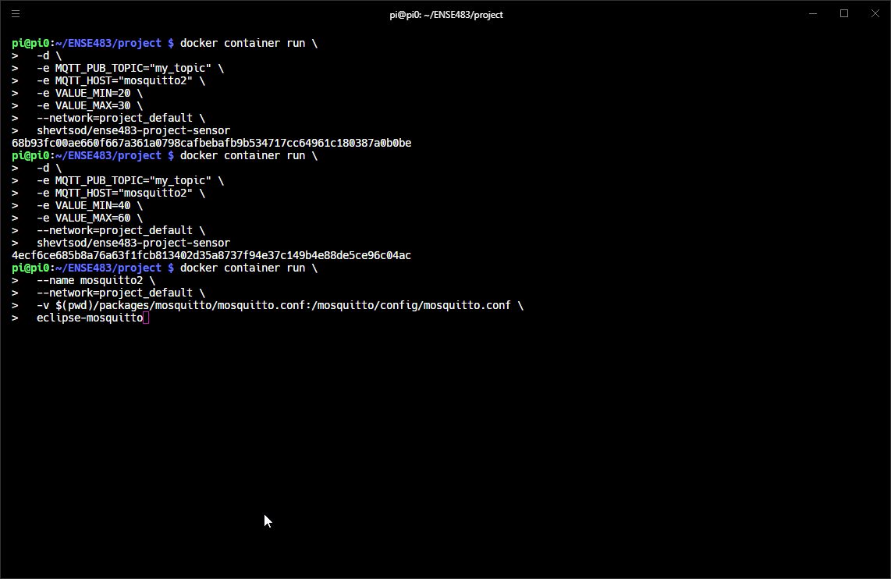
Demo

Slide 51
Gateway

Slide 52
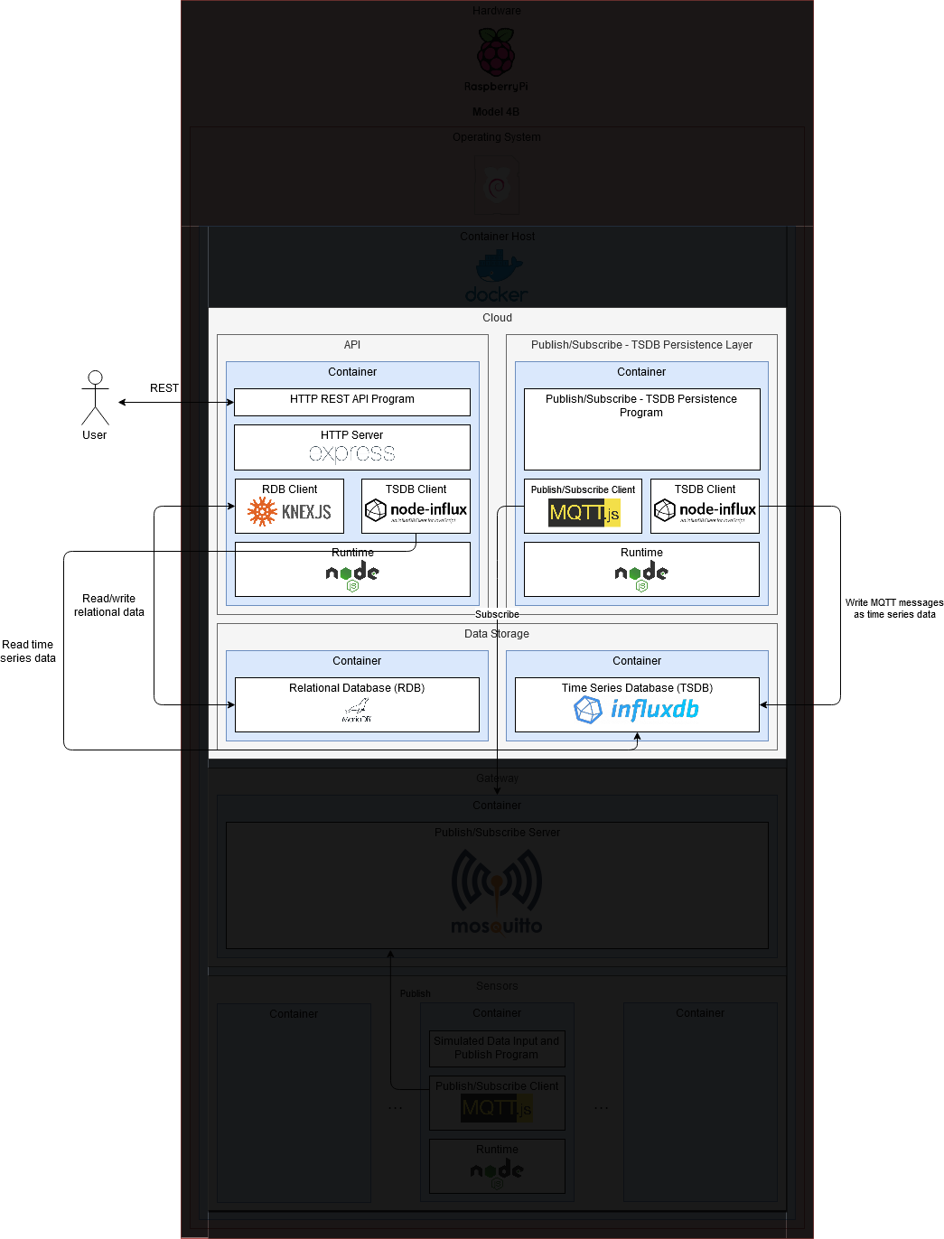
Cloud

Slide 53
Cloud
The final destination for data
Receive data from gateway(s)
Process data
Store data long-term
Provide way for users to interact with data
Only one cloud
Notes:
Has many sub-components

Slide 54
Cloud

Slide 55
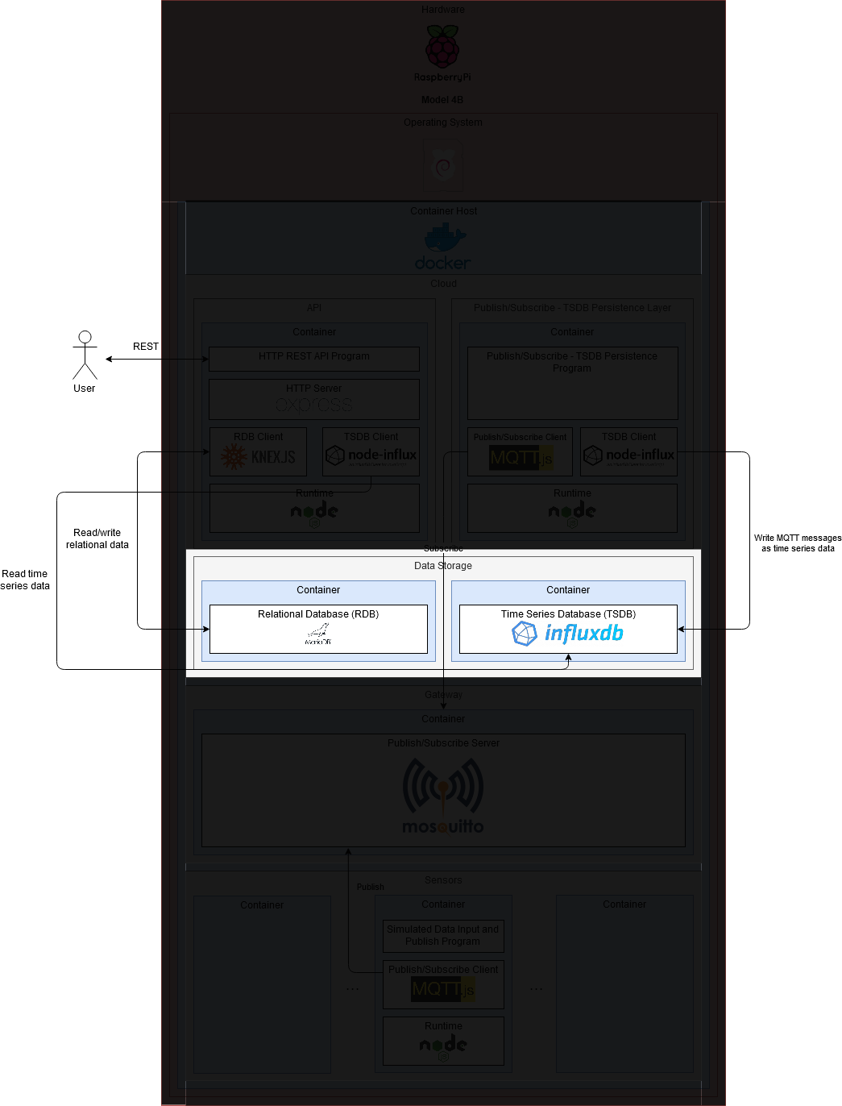
Cloud - Storage

Slide 56
Cloud - Storage
Need to store data long-term
“Persistence”
Two types of data
Relational
Time series

Slide 57
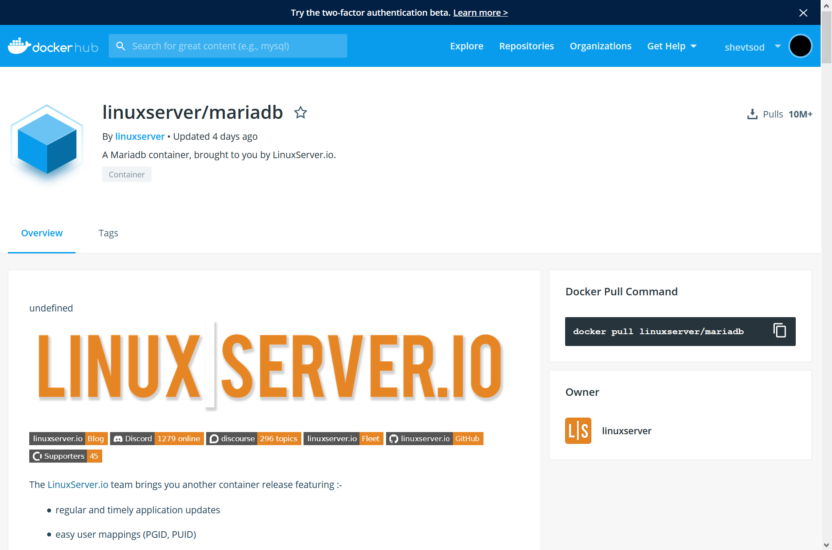
MariaDB
An open-source Relational Database Management System (RDBMS)
Available as a Docker image
docker container run \
-e MYSQL_DATABASE=project \
-e MYSQL_USER=project_admin \
-e MYSQL_PASSWORD=password \
linuxserver/mariadb

Slide 58
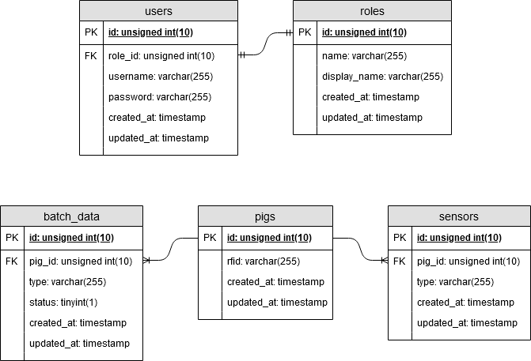
Relational database design

Slide 59
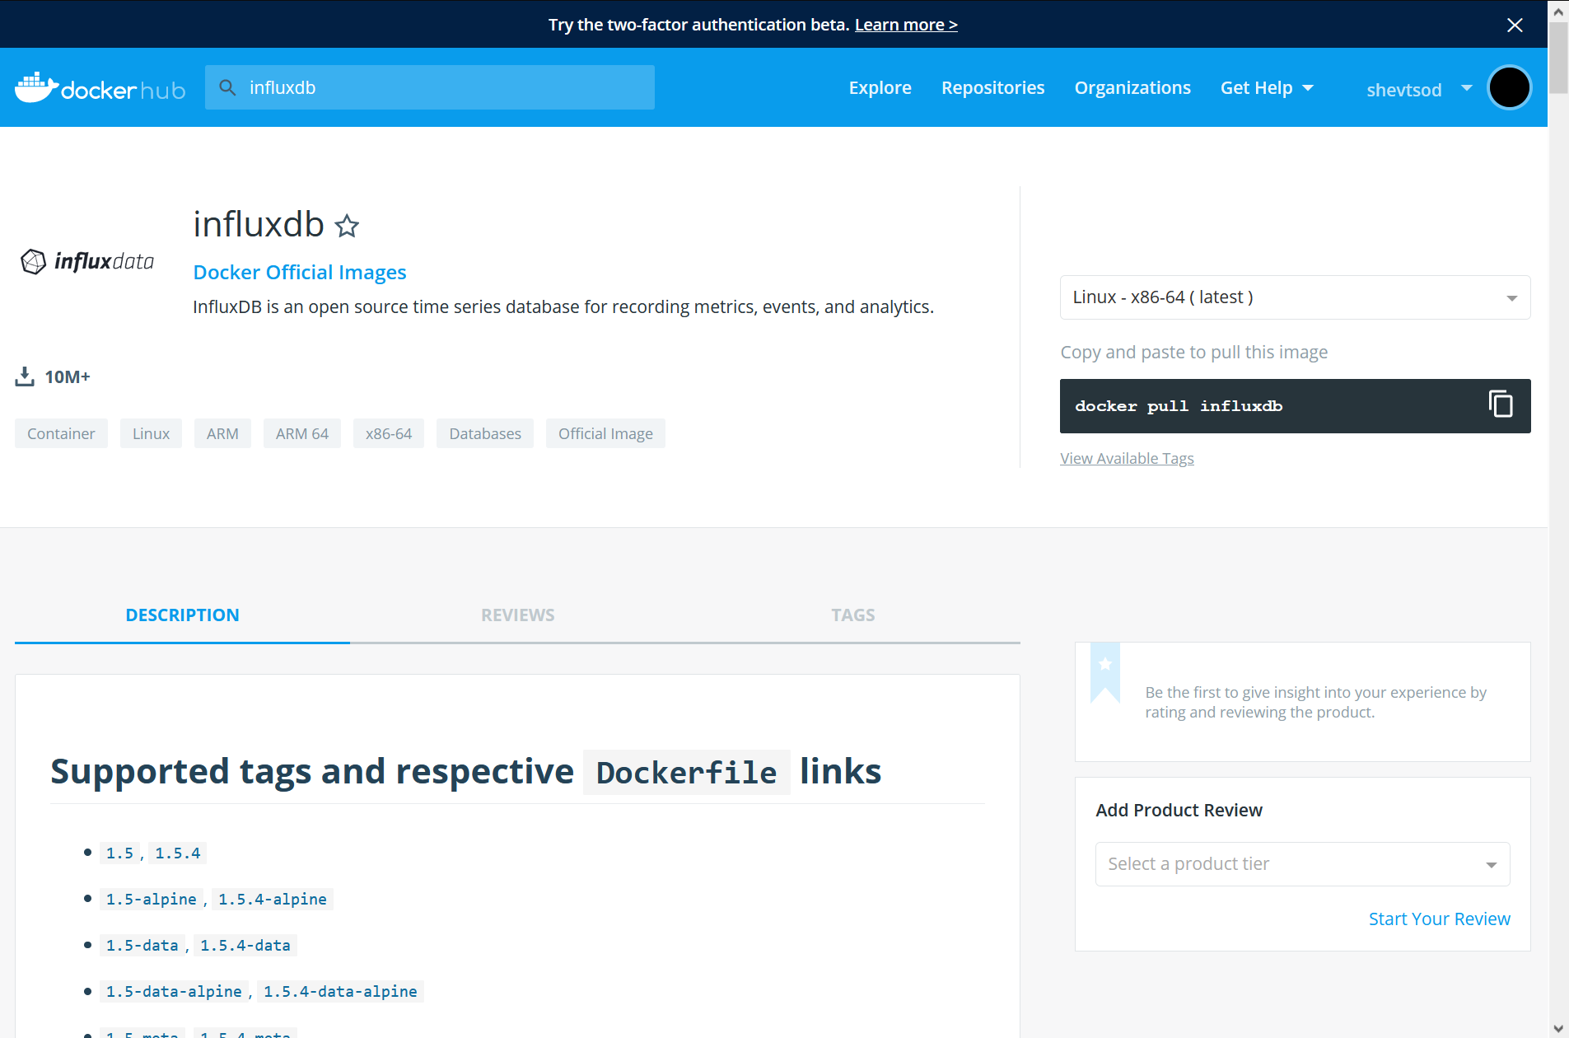
InfluxDB
An open-source time series database
Available as a Docker image
docker container run influxdb

Slide 60
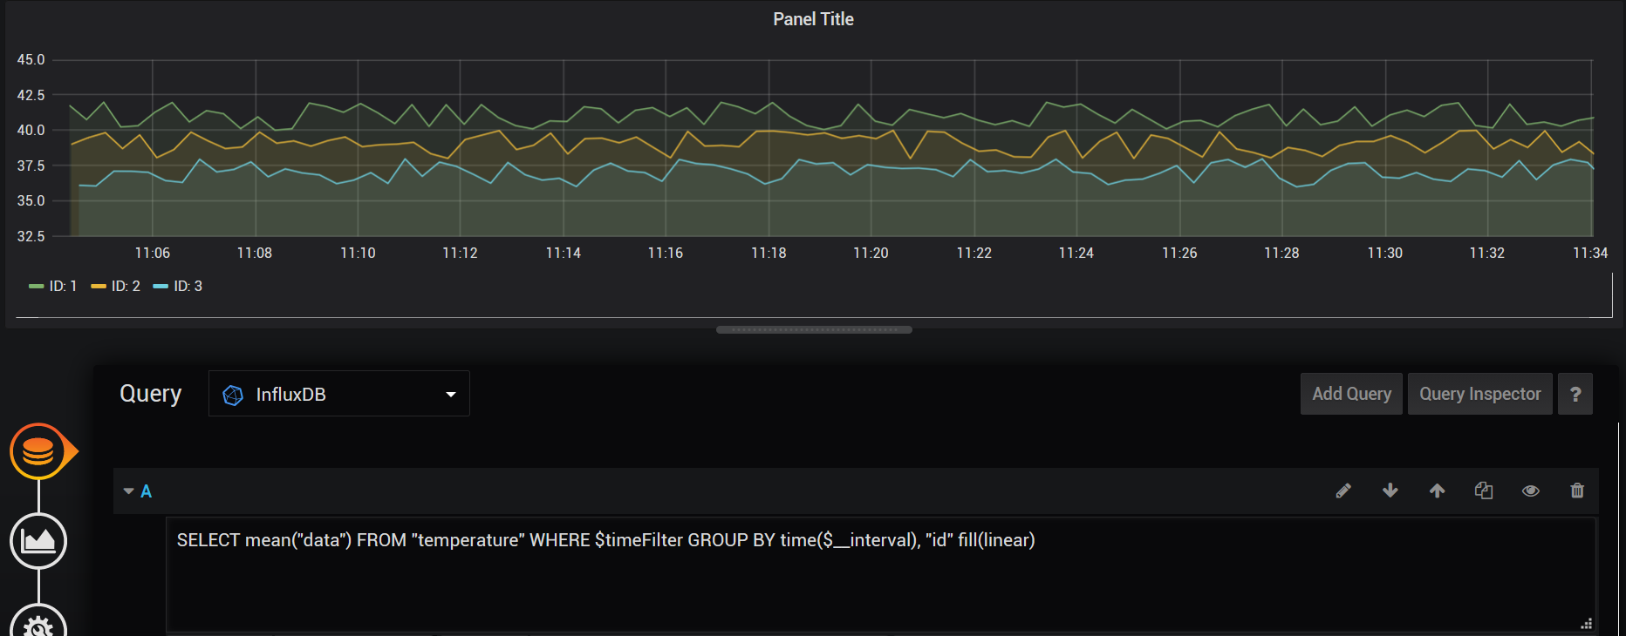
Why InfluxDB?
Relational databases best used for relational data
Time series databases optimized for storing time series
Works out-of-the-box with a familiar SQL-like query language

Slide 61
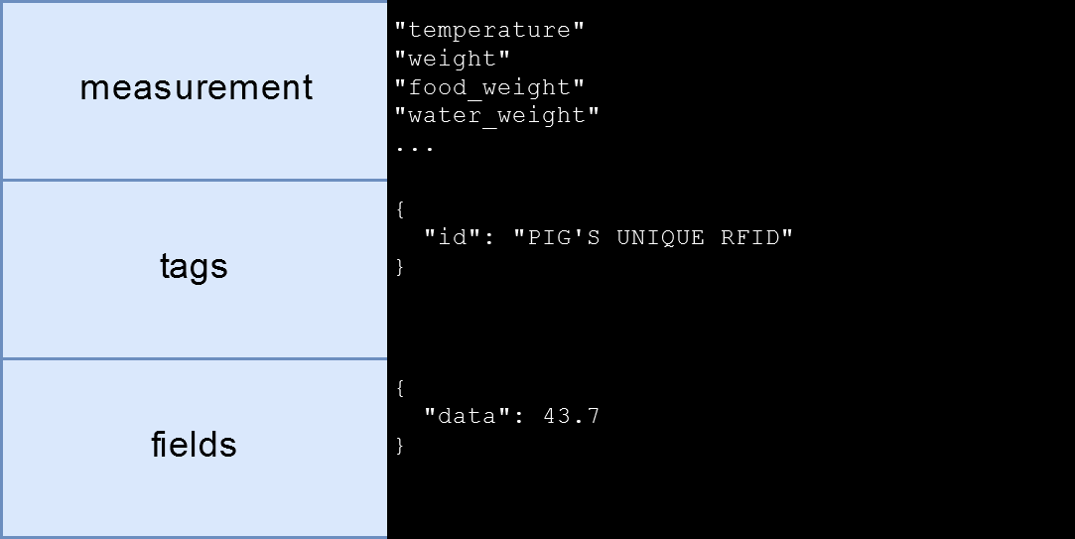
Time series database design
Three pieces of information in an InfluxDB data point:
Measurement
Tags
Fields
Notes:
Measurement: name of the measurement
Tags: Extra metadata (like ID)
Fields: values of measurements

Slide 62
docker-compose.yml entries
version: "3.0"
services:
# MariaDB - Relational database
# https://hub.docker.com/r/linuxserver/mariadb
mariadb:
image: linuxserver/mariadb:110.4.10mariabionic-ls44
container_name: mariadb
restart: always
volumes:
- mariadb_data:/config
environment:
MYSQL_DATABASE: project
MYSQL_USER: project_admin
MYSQL_PASSWORD: ${DB_PASSWORD}
# InfluxDB - Time series database
# https://hub.docker.com/_/influxdb
influxdb:
image: influxdb:1.7
container_name: influxdb
restart: always
volumes:
- influxdb_data:/var/lib/influxdb
environment:
INFLUXDB_HTTP_AUTH_ENABLED: "true"
INFLUXDB_ADMIN_USER: root
INFLUXDB_DB: project
INFLUXDB_USER: project_admin
INFLUXDB_USER_PASSWORD: ${DB_PASSWORD}

Slide 63
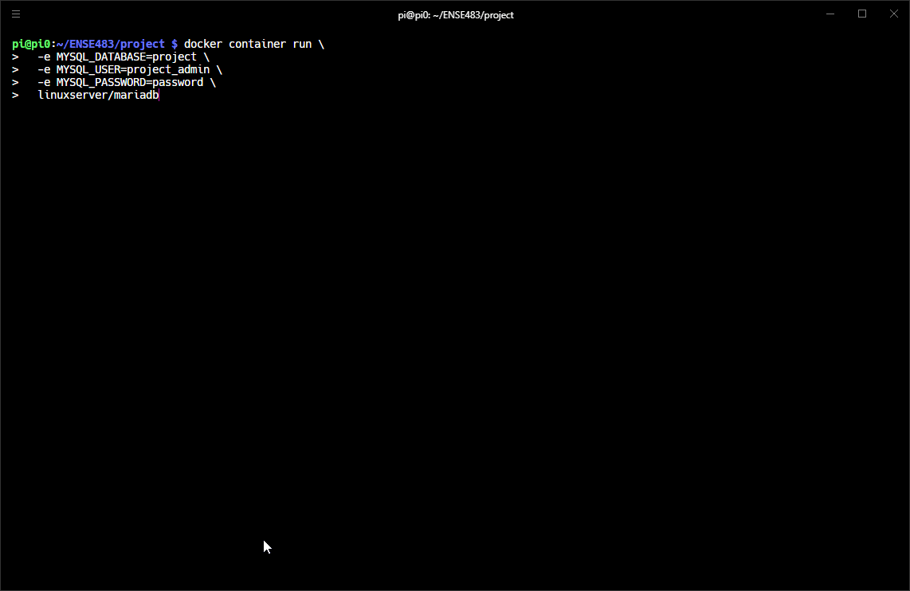
Demo - MariaDB

Slide 64
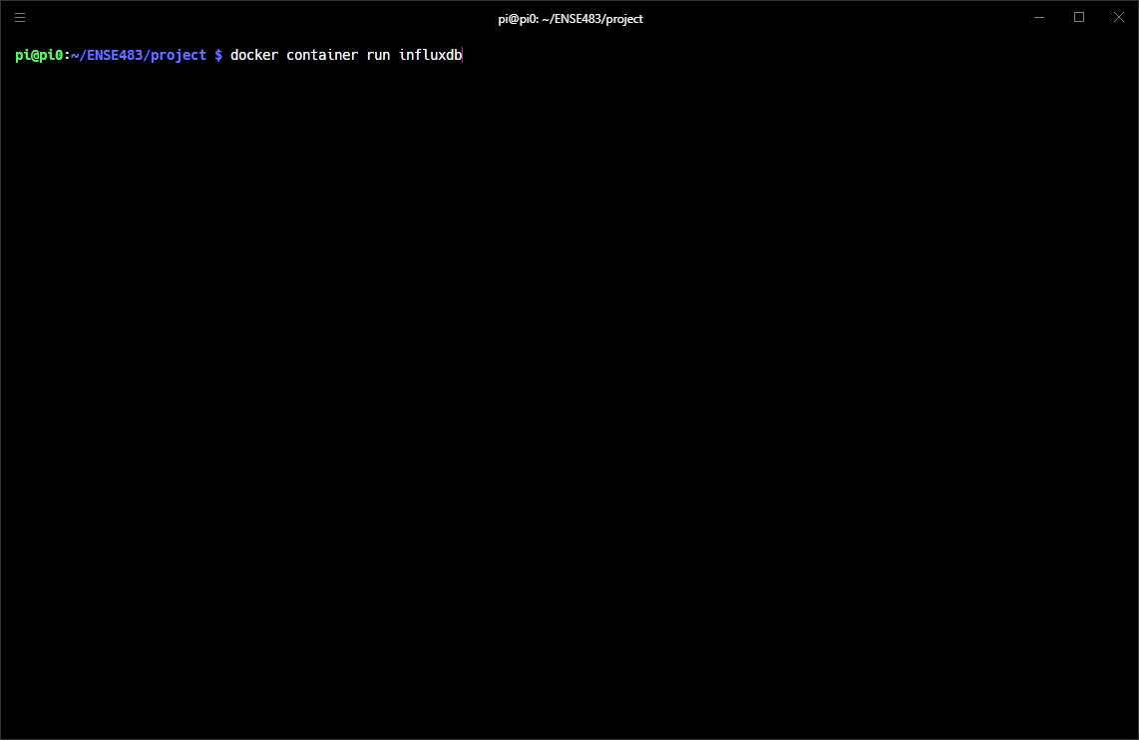
Demo - InfluxDB

Slide 65
Cloud - Storage

Slide 66
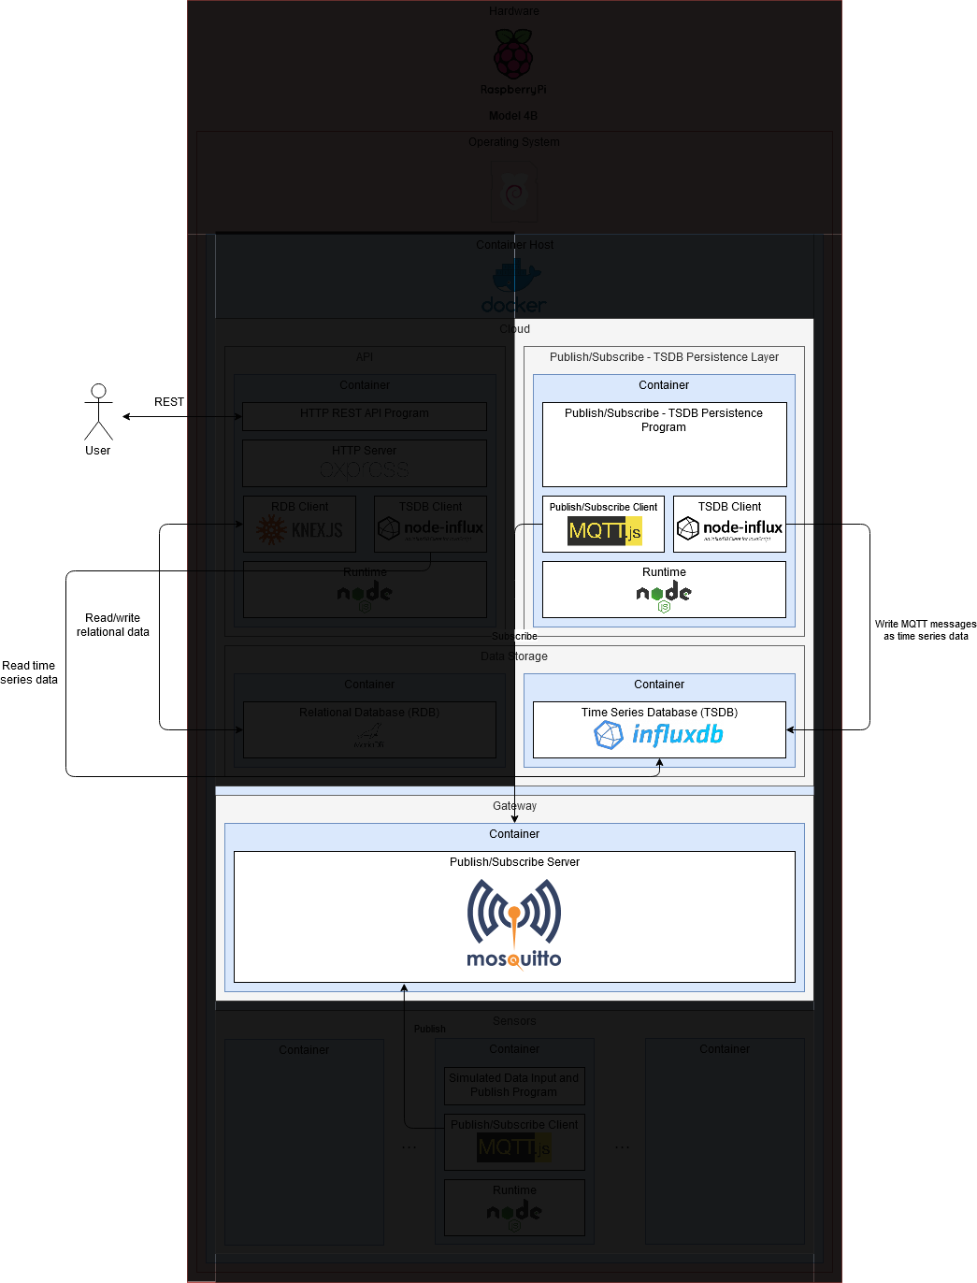
Cloud - Sensor Persistence

Slide 67
Cloud - Sensor Persistence
Need a way to route data from Mosquitto to InfluxDB
Persist MQTT messages

Slide 68
Requirements for the sensor persistence program
Connect to an MQTT server
Connect to an InfluxDB server
Subscribe to all MQTT messages
When message received, convert to an InfluxDB measurement
Insert measurement in InfluxDB

Slide 69
MQTT.js
An MQTT client library hosted on NPM
Event-driven API
// When connected, subscribe to all MQTT topics wildcard (#) to receive
// all messages
mqttClient.on('connect', () => {
mqttClient.subscribe('#');
});
// When an MQTT message is received
mqttClient.on('message', (topic, message) => {
// Do something!
});

Slide 70
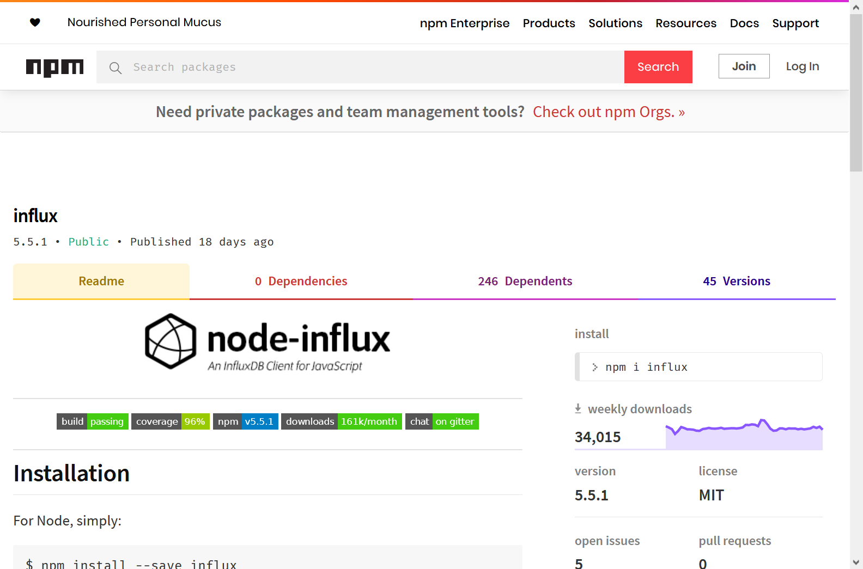
node-influx
An InfluxDB client library on NPM
Object-oriented API
influxClient = new influx.InfluxDB({
host: env.INFLUX_HOST,
port: env.INFLUX_PORT,
database: env.INFLUX_DB,
username: env.INFLUX_USERNAME,
password: env.INFLUX_PASSWORD,
});
// Parse the MQTT topic to the measurement to store in InfluxDB
const parsedTopic = parseMQTTTopic(topic);
// InfluxDB measurement body/content
const influxPayload = [
{
tags: { id: parsedTopic.tags[0] },
fields: JSON.parse(message),
},
];
// Persist measurement in InfluxDB
influxClient.writeMeasurement(parsedTopic.measurement, influxPayload)

Slide 71
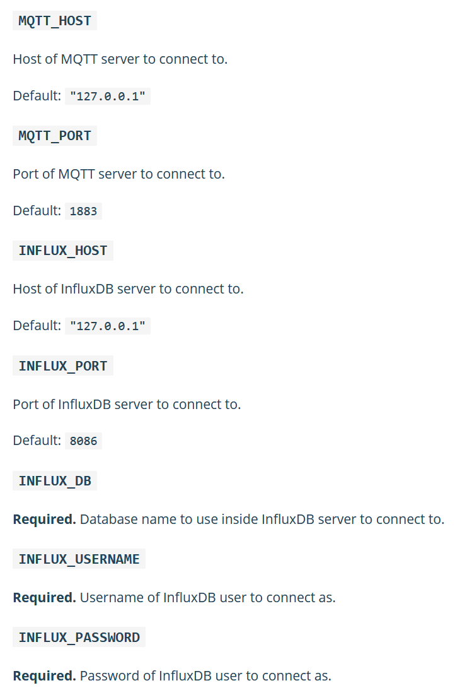
Environment variables

Slide 72
Dockerfile
# Version of Node.js to use
FROM node:12-alpine
LABEL maintainer="Daniel Shevtsov <daniel.shevtsov@gmail.com>"
# Set node environment with default to production
ARG NODE_ENV=production
ENV NODE_ENV $NODE_ENV
# Create app directory
WORKDIR /usr/src/app
# Set the app user as the owner of the app directory
RUN chown node:node .
# Set user to run app
USER node
# Install app dependencies
COPY --chown=node:node package*.json ./
RUN npm ci --only=production
# Bundle app source
COPY --chown=node:node . .
# Run app
CMD ["node", "src/index"]

Slide 73
docker-compose.yml entries
version: "3.0"
services:
# MQTT - InfluxDB Persister
mqtt-influx-persister:
build: ./packages/mqtt-influx-persister
image: shevtsod/ense483-project-mqtt-influx-persister
container_name: mqtt-influx-persister
restart: always
environment:
MQTT_HOST: mosquitto
INFLUX_HOST: influxdb
INFLUX_DB: project
INFLUX_USERNAME: project_admin
INFLUX_PASSWORD: ${DB_PASSWORD}
depends_on:
- influxdb

Slide 74
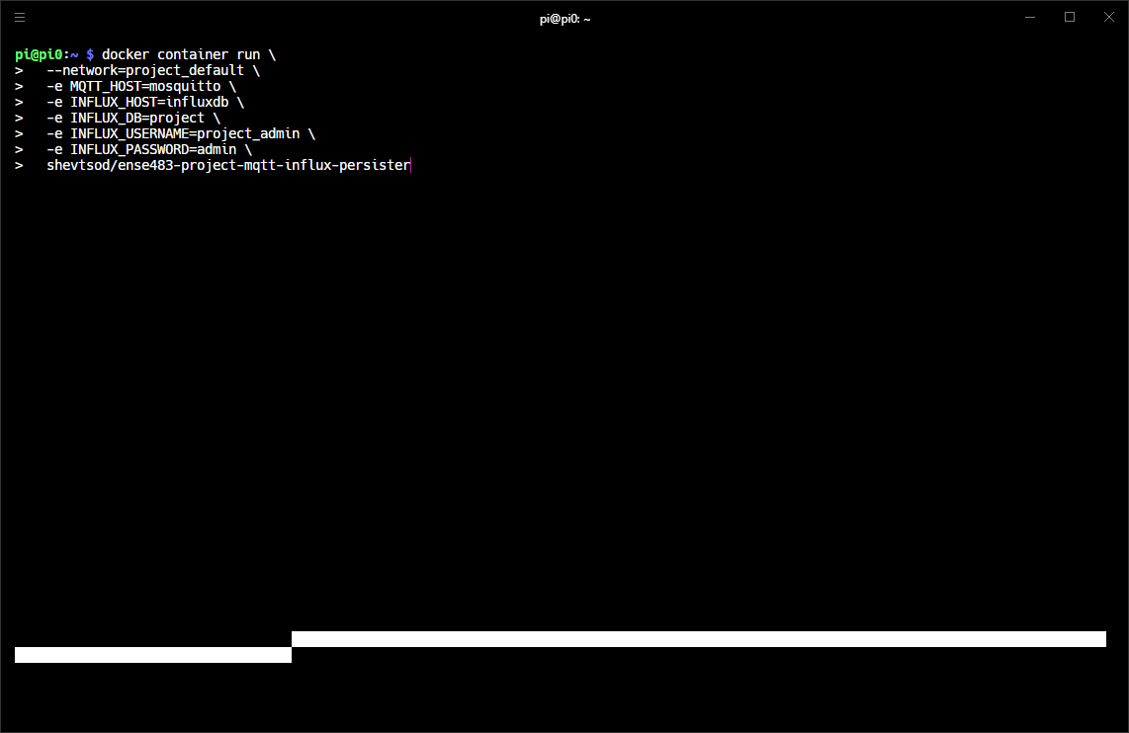
Demo

Slide 75
Cloud - Sensor Persistence

Slide 76
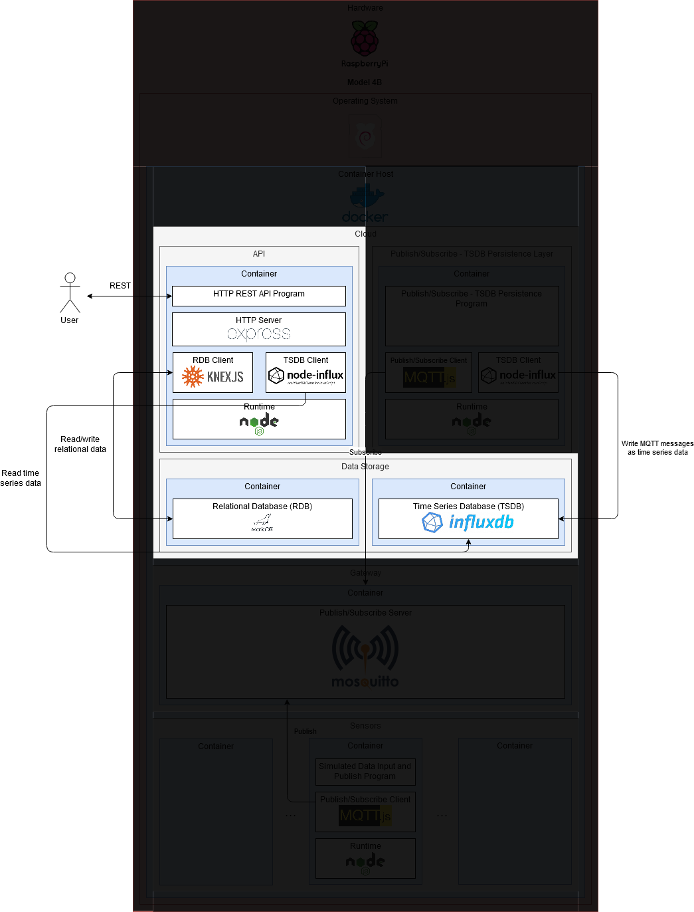
Cloud - API

Slide 77
Cloud - API
Talks with databases
Allows users to use CRUD operations
REST API (CRUD over HTTP)
Notes:
Now MQTT is out of the picture, only dealing with persistent storage

Slide 78
Requirements for the API
Connect to a MariaDB server
Connect to an InfluxDB server
Provide access to users over HTTP
Handle data validation
Handle user authentication and authorization
Allow reading/writing data using CRUD operations:
Create
Read
Update
Delete

Slide 79
node-influx
An InfluxDB client library on NPM
Object-oriented API
influxClient = new influx.InfluxDB({
host: env.INFLUX_HOST,
port: env.INFLUX_PORT,
database: env.INFLUX_DB,
username: env.INFLUX_USERNAME,
password: env.INFLUX_PASSWORD,
});
// Parse the MQTT topic to the measurement to store in InfluxDB
const parsedTopic = parseMQTTTopic(topic);
// InfluxDB measurement body/content
const influxPayload = [
{
tags: { id: parsedTopic.tags[0] },
fields: JSON.parse(message),
},
];
// Persist measurement in InfluxDB
influxClient.writeMeasurement(parsedTopic.measurement, influxPayload)

Slide 80
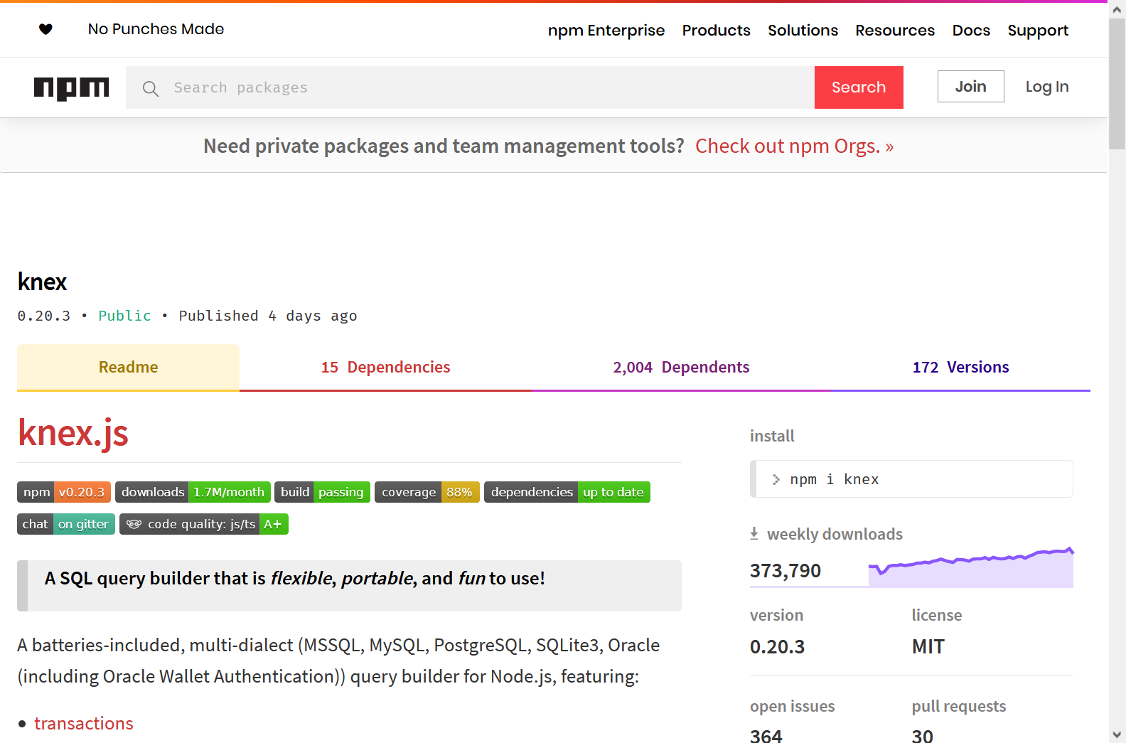
knex.js
An SQL driver, schema builder, and query builder on NPM
Object-oriented API
const knex = Knex({
client: 'mysql',
connection: {
host: env.DB_HOST,
port: env.DB_PORT,
database: env.DB_DB,
user: env.DB_USERNAME,
password: env.DB_PASSWORD,
},
});
knex.raw('SELECT "test connection"')
.then(() => {
logger.info('Connected to SQL database server');
})
.catch((err) => {
logger.error(
`Failed to connect to SQL database.\n ${err.stack}`,
);
process.exit(1);
});
Notes:
Low level, allows running basic SQL queries

Slide 81
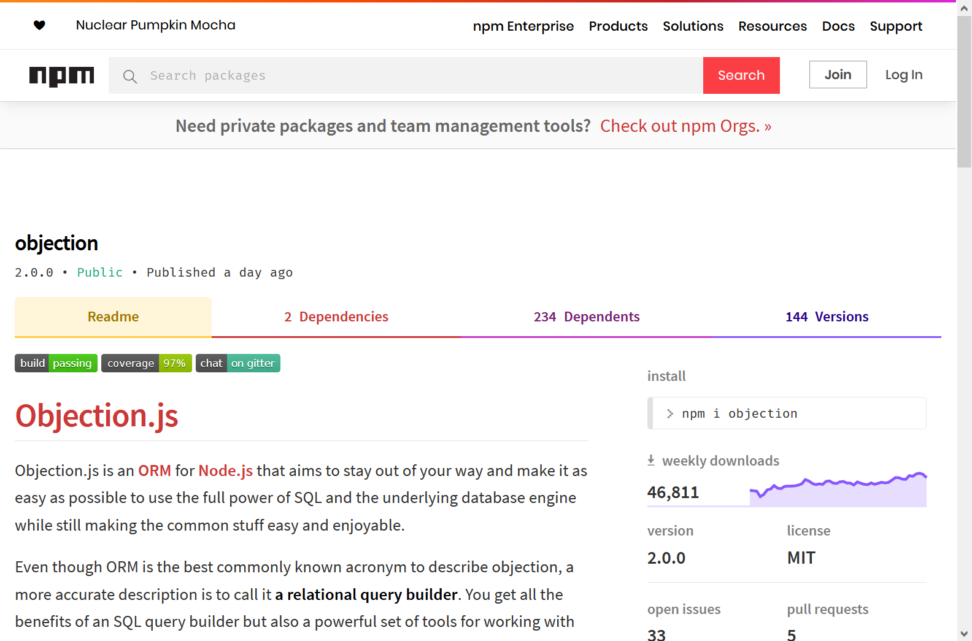
Objection.js
An Object-Relational Mapper (ORM) on NPM
Object-oriented API
// Give the knex instance to objection.
Model.knex(knex);
// Represents a user of the application.
class User extends Model {
static get tableName() {
return 'users';
}
static get relationMappings() {
return {
role: {
relation: Model.BelongsToOneRelation,
modelClass: Role,
join: {
from: 'users.role_id',
to: 'roles.id',
},
},
};
}
}
Notes:
Higher level, represent database tables as JavaScript objects (models)

Slide 82

express
A web framework and HTTP server on NPM
Object-oriented and functional API
const app = express();
app.get('/', function (req, res) {
res.json({
message: 'Hello World'
})
});
app.listen(3000);

Slide 83
CRUD? REST?
CRUD | REST
CREATE | HTTP POST
READ (COLLECTION) | HTTP GET
READ (ONE RESOURCE) | HTTP GET
UPDATE (FULL) | HTTP PUT
UPDATE (PARTIAL) | HTTP PATCH
DELETE | HTTP DELETE
Notes:
REST APIs map CRUD operations to verbs in the HTTP protocol

Slide 84
CRUD? REST?
CREATE
POST /users
READ (COLLECTION)
GET /users
READ (ONE RESOURCE)
GET /users/1
UPDATE (FULL)
PUT /users/1

Slide 85
CRUD? REST?
UPDATE (PARTIAL)
PATCH /users/1
DELETE
DELETE /users/1

Slide 86


Environment variables

Slide 87
Dockerfile
# Version of Node.js to use
FROM node:12-alpine
LABEL maintainer="Daniel Shevtsov <daniel.shevtsov@gmail.com>"
# Download native dependencies
# See https://github.com/kelektiv/node.bcrypt.js/wiki/Installation-Instructions#alpine-linux-based-images
RUN apk --no-cache add --virtual builds-deps build-base python
# Set node environment with default to production
ARG NODE_ENV=production
ENV NODE_ENV $NODE_ENV
# default to port 3000 for node, and 9229 and 9230 (tests) for debug
ARG PORT=8080
ENV PORT $PORT
# Create app directory
WORKDIR /usr/src/app
# Set the app user as the owner of the app directory
RUN chown node:node .
# Set user to run app
USER node
# Install app dependencies
COPY --chown=node:node package*.json ./
# NOTE: Rebuild bcrypt based on official instructions.
# See https://github.com/kelektiv/node.bcrypt.js/wiki/Installation-Instructions#alpine-linux-based-images
RUN npm ci --only=production && \
npm rebuild bcrypt --build-from-source
# Bundle app source
COPY --chown=node:node . .
# Expose app ports
EXPOSE $PORT
# Pre-configure app
ENTRYPOINT ["./docker-entrypoint.sh"]
# Start app
CMD ["node", "src/index"]

Slide 88
docker-compose.yml entries
version: "3.0"
services:
# API
api:
build: ./packages/api
image: shevtsod/ense483-project-api
container_name: api
restart: always
ports:
- "8081:8080"
environment:
HOST: api
SECRET_KEY: ${SECRET_KEY}
DB_HOST: mariadb
DB_DB: project
DB_USERNAME: project_admin
DB_PASSWORD: ${DB_PASSWORD}
INFLUX_HOST: influxdb
INFLUX_DB: project
INFLUX_USERNAME: project_admin
INFLUX_PASSWORD: ${DB_PASSWORD}
depends_on:
- mariadb
- influxdb

Slide 89

Demo

Slide 90

Demo - HTTP API
Unauthorized requests are ignored

Slide 91

Demo - HTTP API
Getting an access token

Slide 92

Demo - HTTP API
Create a user

Slide 93

Demo - HTTP API
Read all pigs

Slide 94

Demo - HTTP API
Read all sensors attached to a pig

Slide 95

Demo - HTTP API
Read sensor measurements
Notes:
Sensor pulled from MariaDB, measurements pulled from InfluxDB

Slide 96

Demo - HTTP API
Fully update a user

Slide 97

Demo - HTTP API
Partially update a user

Slide 98

Demo - HTTP API
Delete a role

Slide 99
Cloud - API

Slide 100
Conclusion

Slide 101
Conclusion
Diagram makes more sense?
Takeaways:
Docker is pretty flexible
Think in terms of data flow from sensor measurement to persistent storage
Any container can be replaced by a physical equivalent
IoT allows for distributed, scalable systems

Slide 102

Demo - Tying everything together!

Slide 103
References
Rizzo, F., Tomasi, R., Conzon, D., & Montanaro, T. (Eds.). (2018). The IoF2020 Use Case Architectures and overview of the related IoT Systems. 221.
Docker Documentation | Docker Documentation. (n.d.). Retrieved November 30, 2019, from https://docs.docker.com/
Docker at 4: Milestones in Docker History. (2017, March 23). Retrieved November 30, 2019, from Container Journal website: https://containerjournal.com/features/docker-4-milestones-docker-history/

Slide 104
THANK YOU!
Questions?

